Slide 1


《生物信息学》干货分享
伊现富
20190818
2019龙星课程
王凯（宾夕法尼亚大学）
2019.07.29-08.02

Slide 2
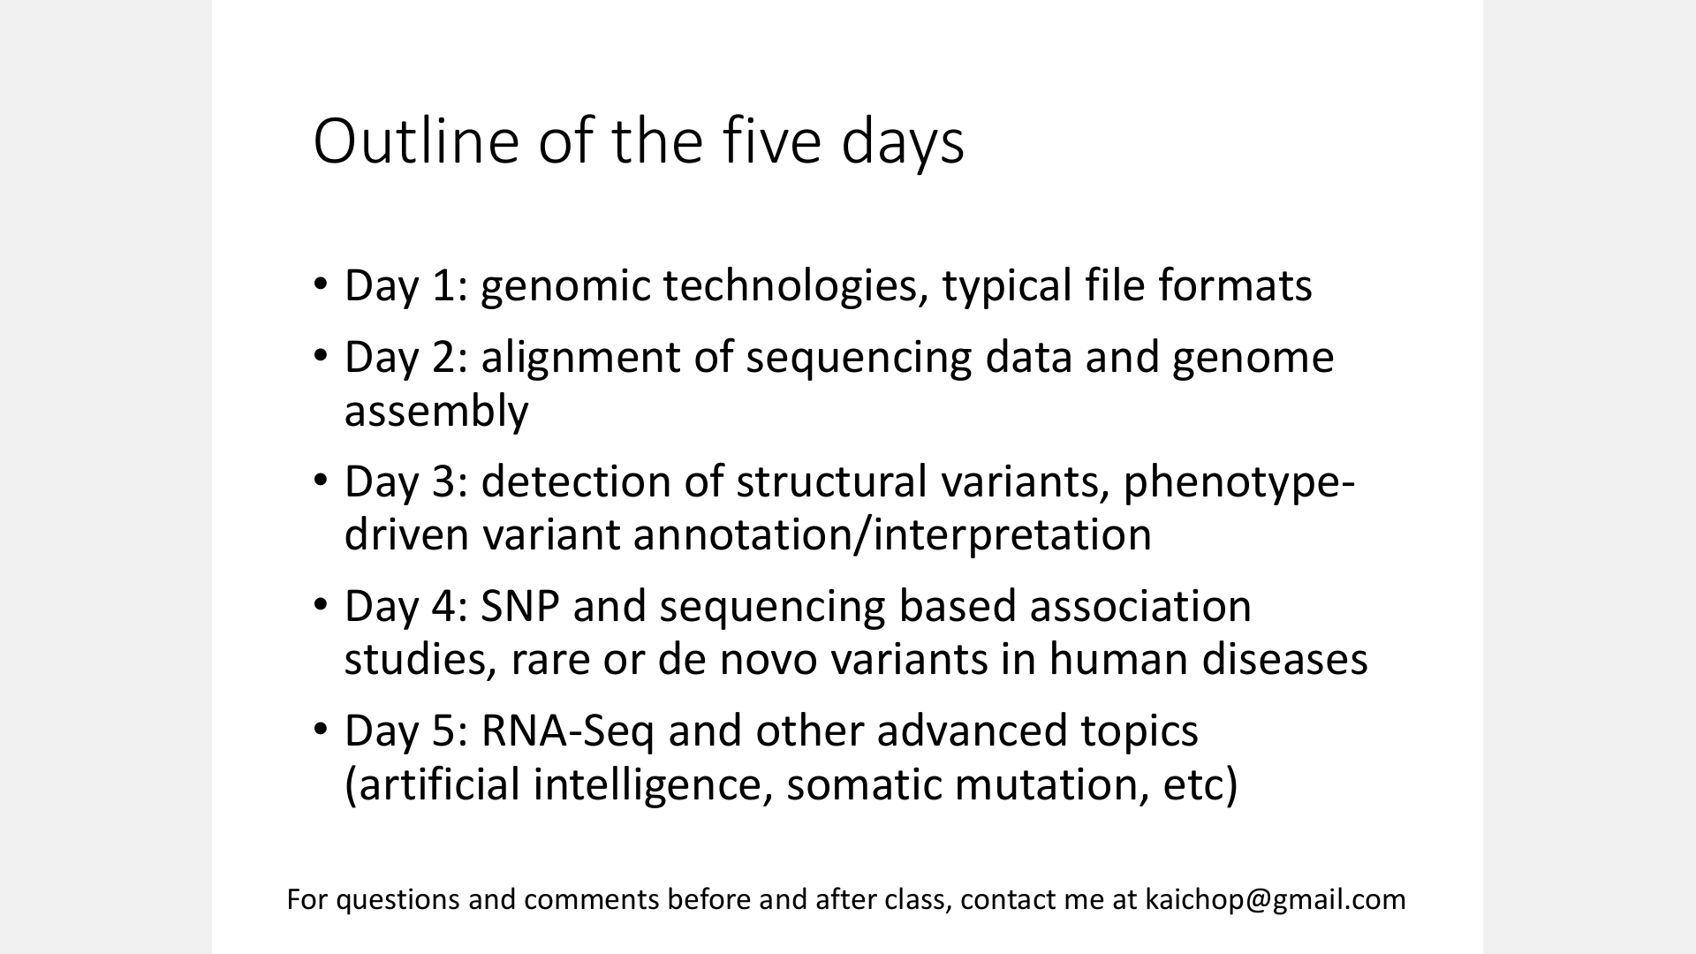

Slide 3
Day 1: Genomic technologies
Illumina sequencing
Single-molecule sequencing

Slide 4
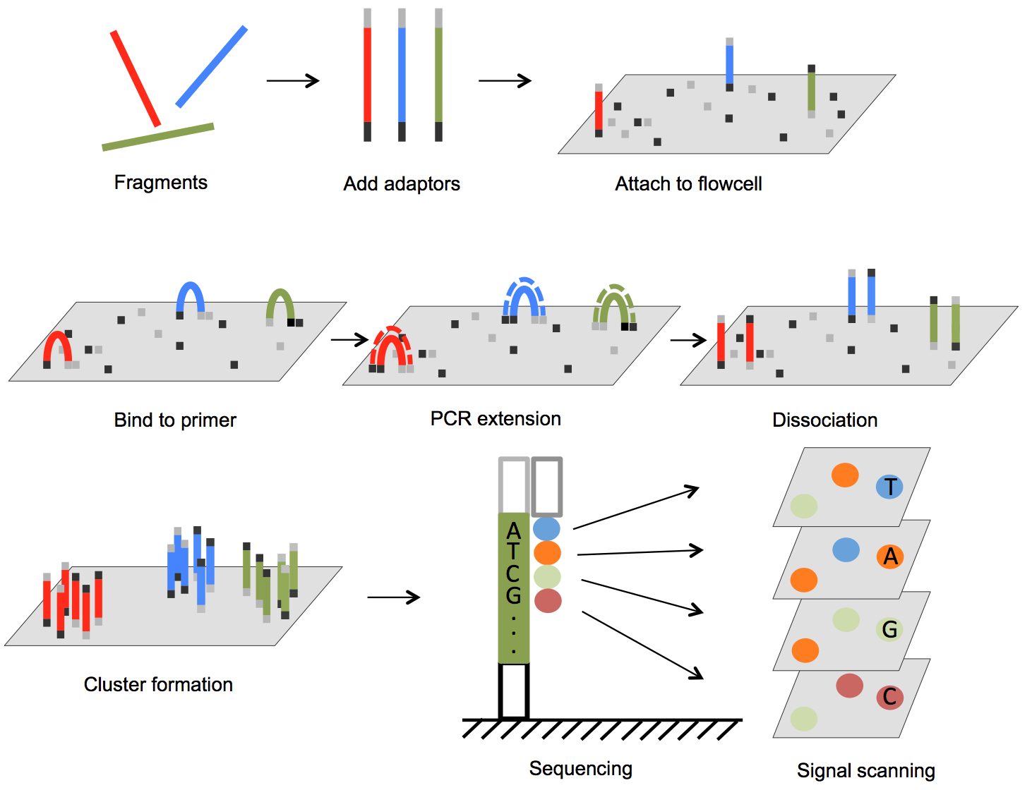
How Illumina sequencing works
桥式扩增
边合成边测序

Slide 5
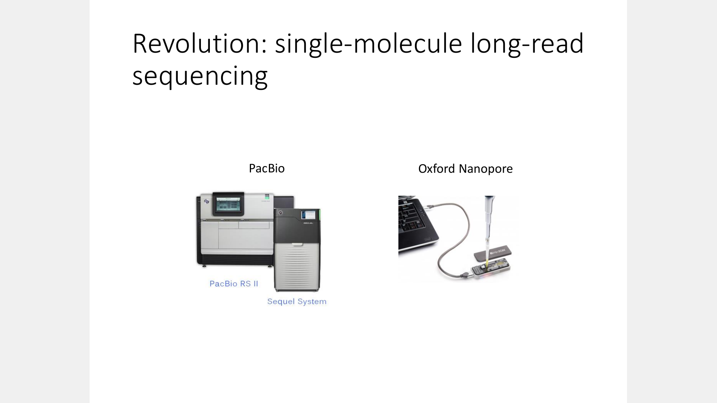

Slide 6
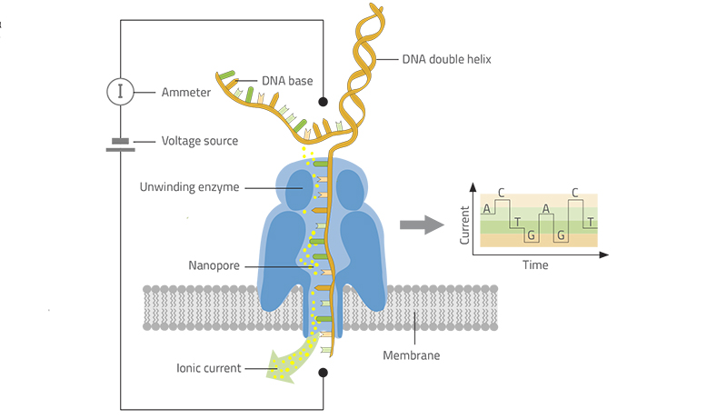
Oxford Nanopore Sequencing

Slide 7
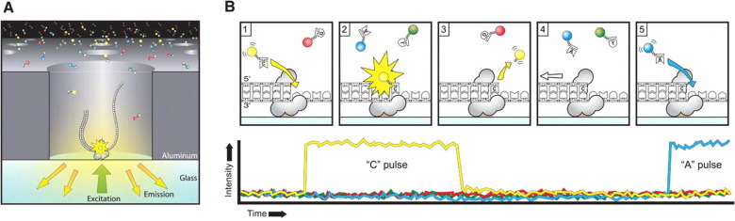
SMRT sequencing

Slide 8
Day 1: Typical file formats
FASTQ
BED
GFF
SAM
VCF

Slide 9
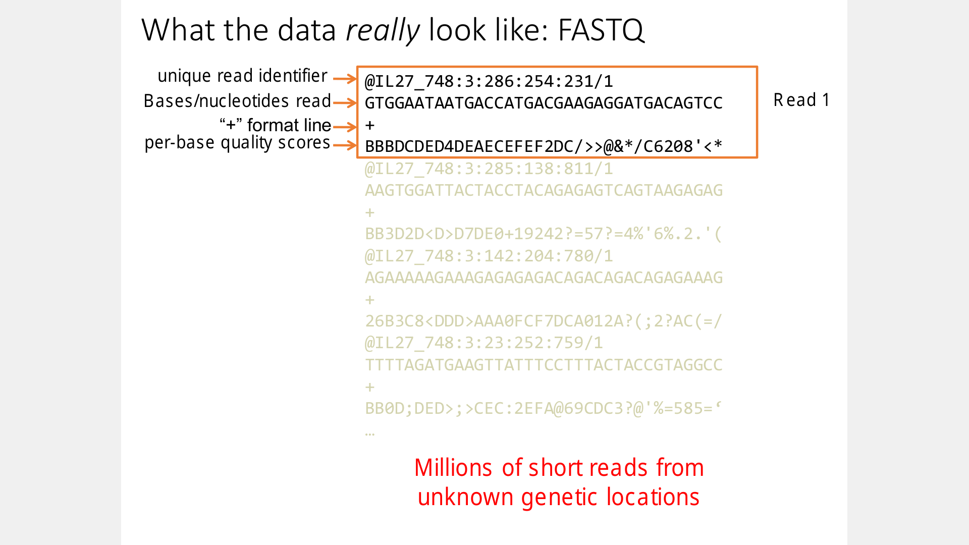

Slide 10
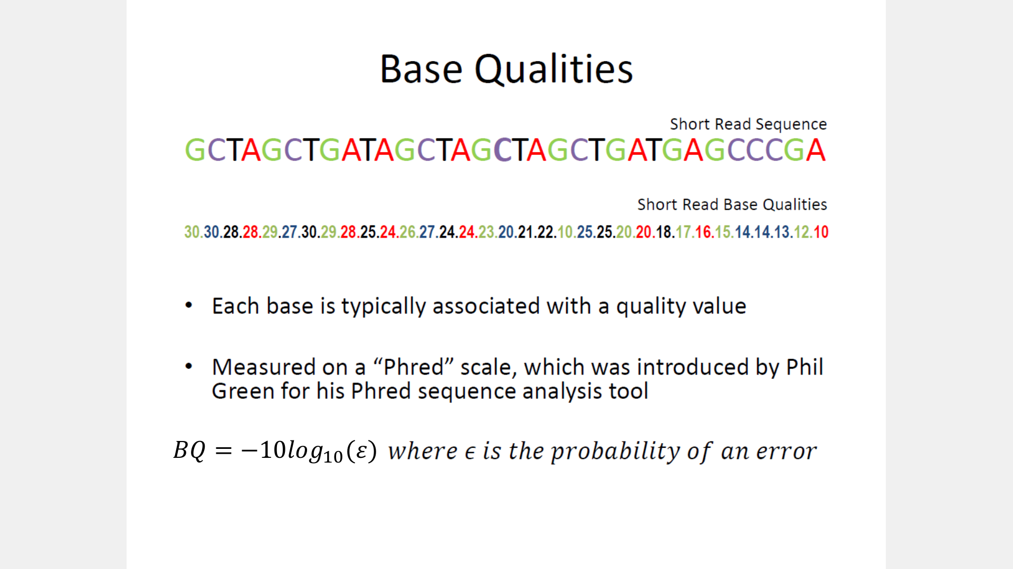

Slide 11
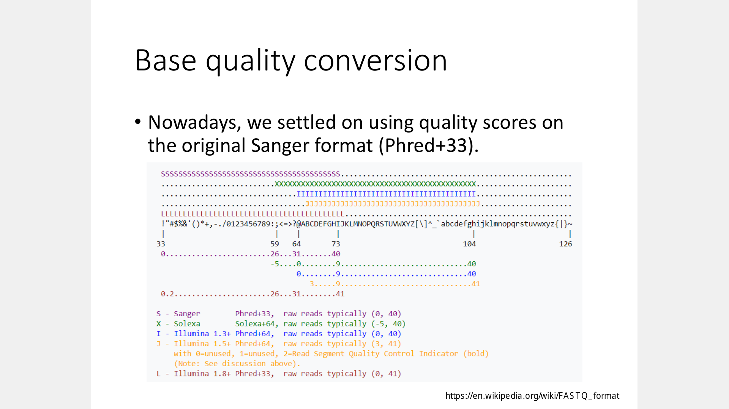

Slide 12
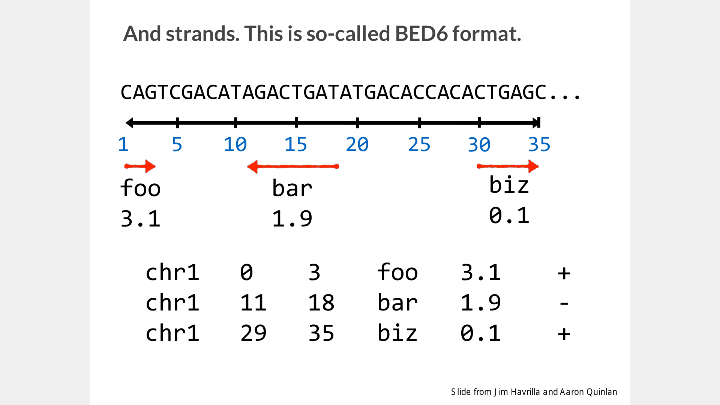

Slide 13
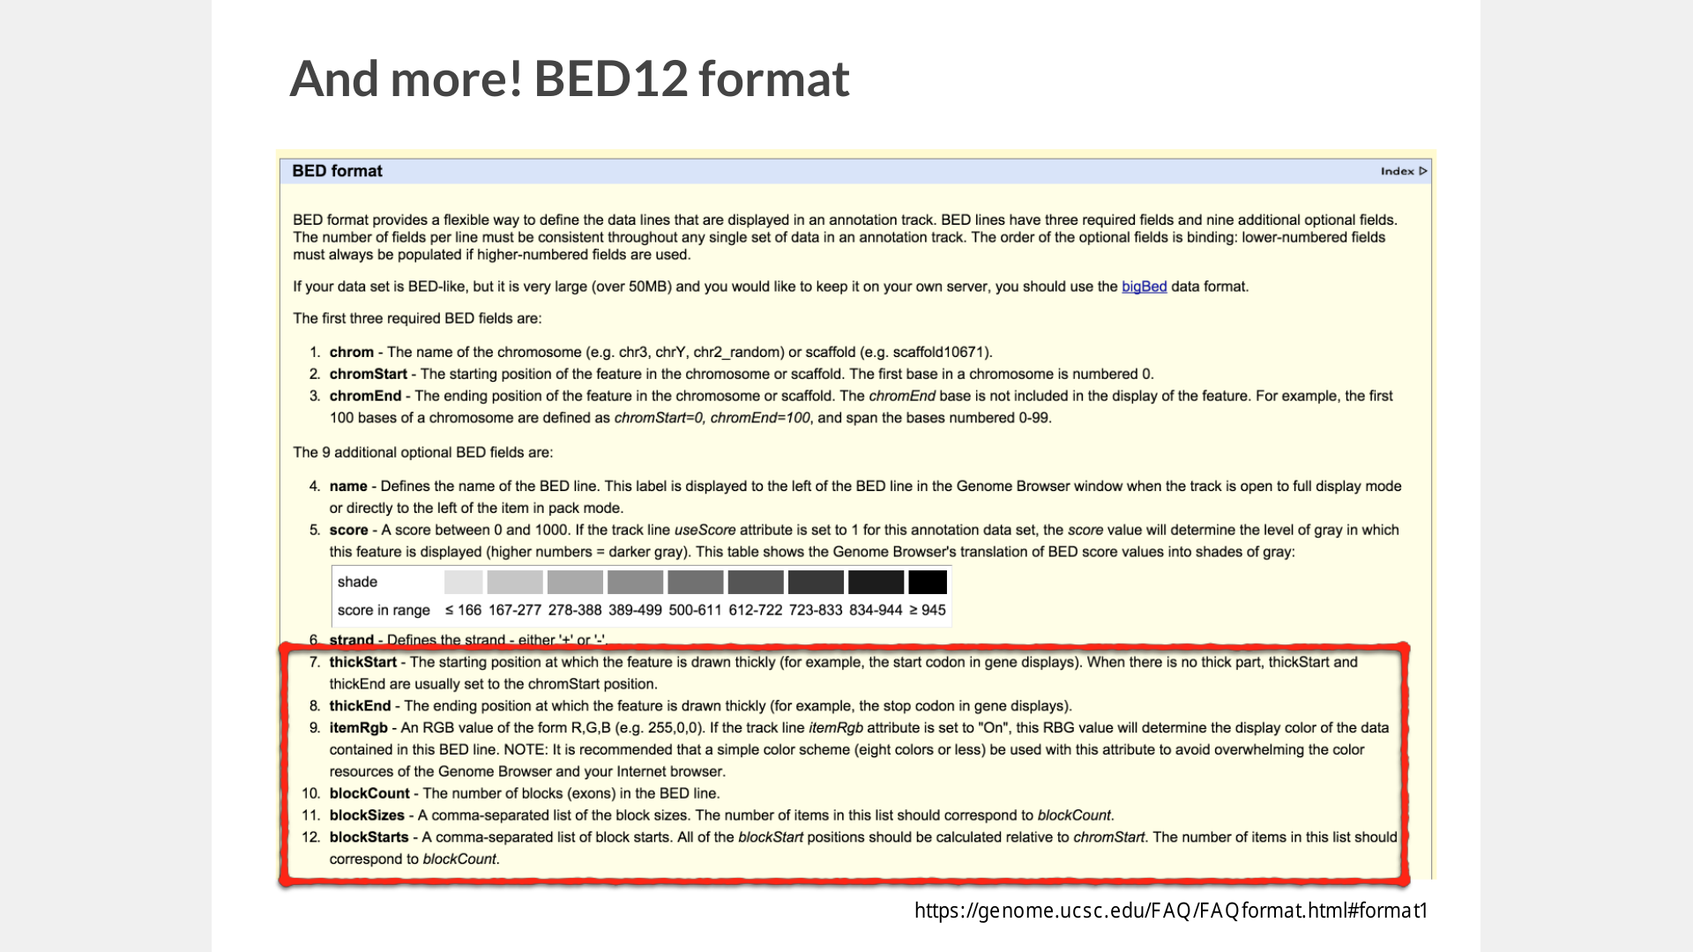

Slide 14
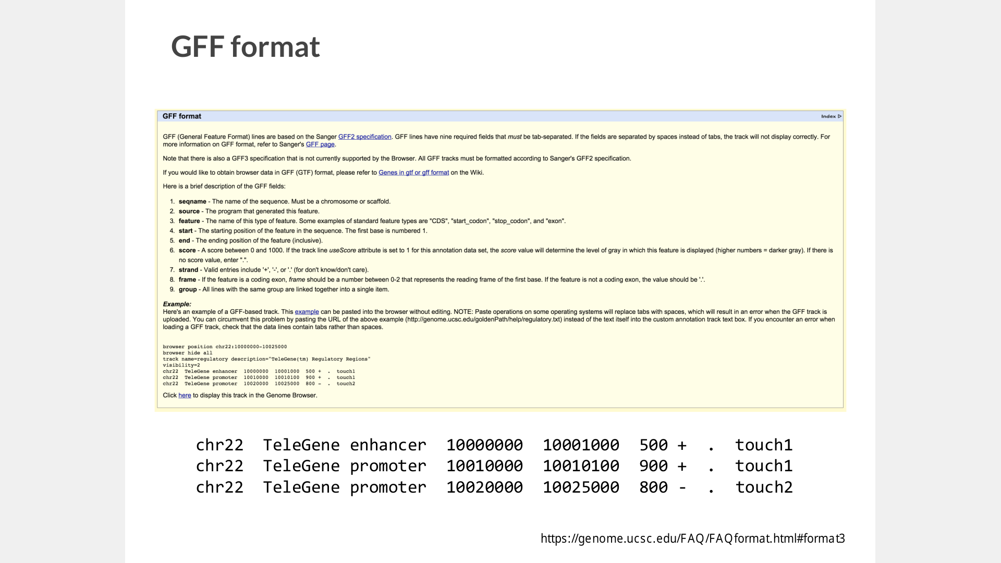

Slide 15
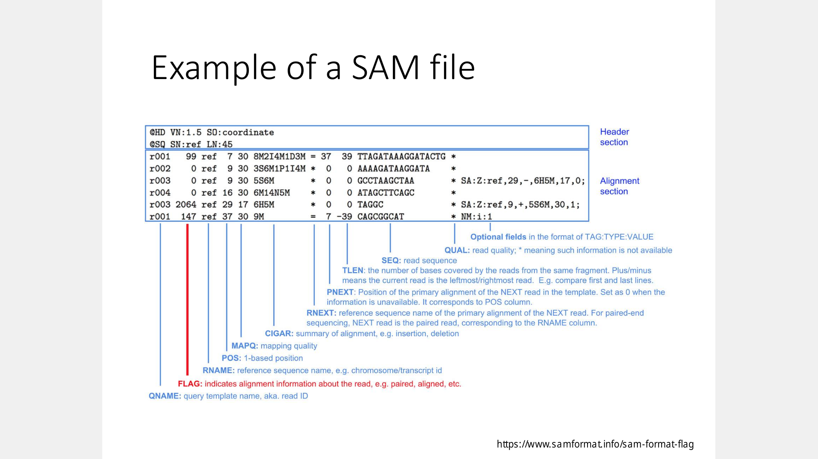

Slide 16
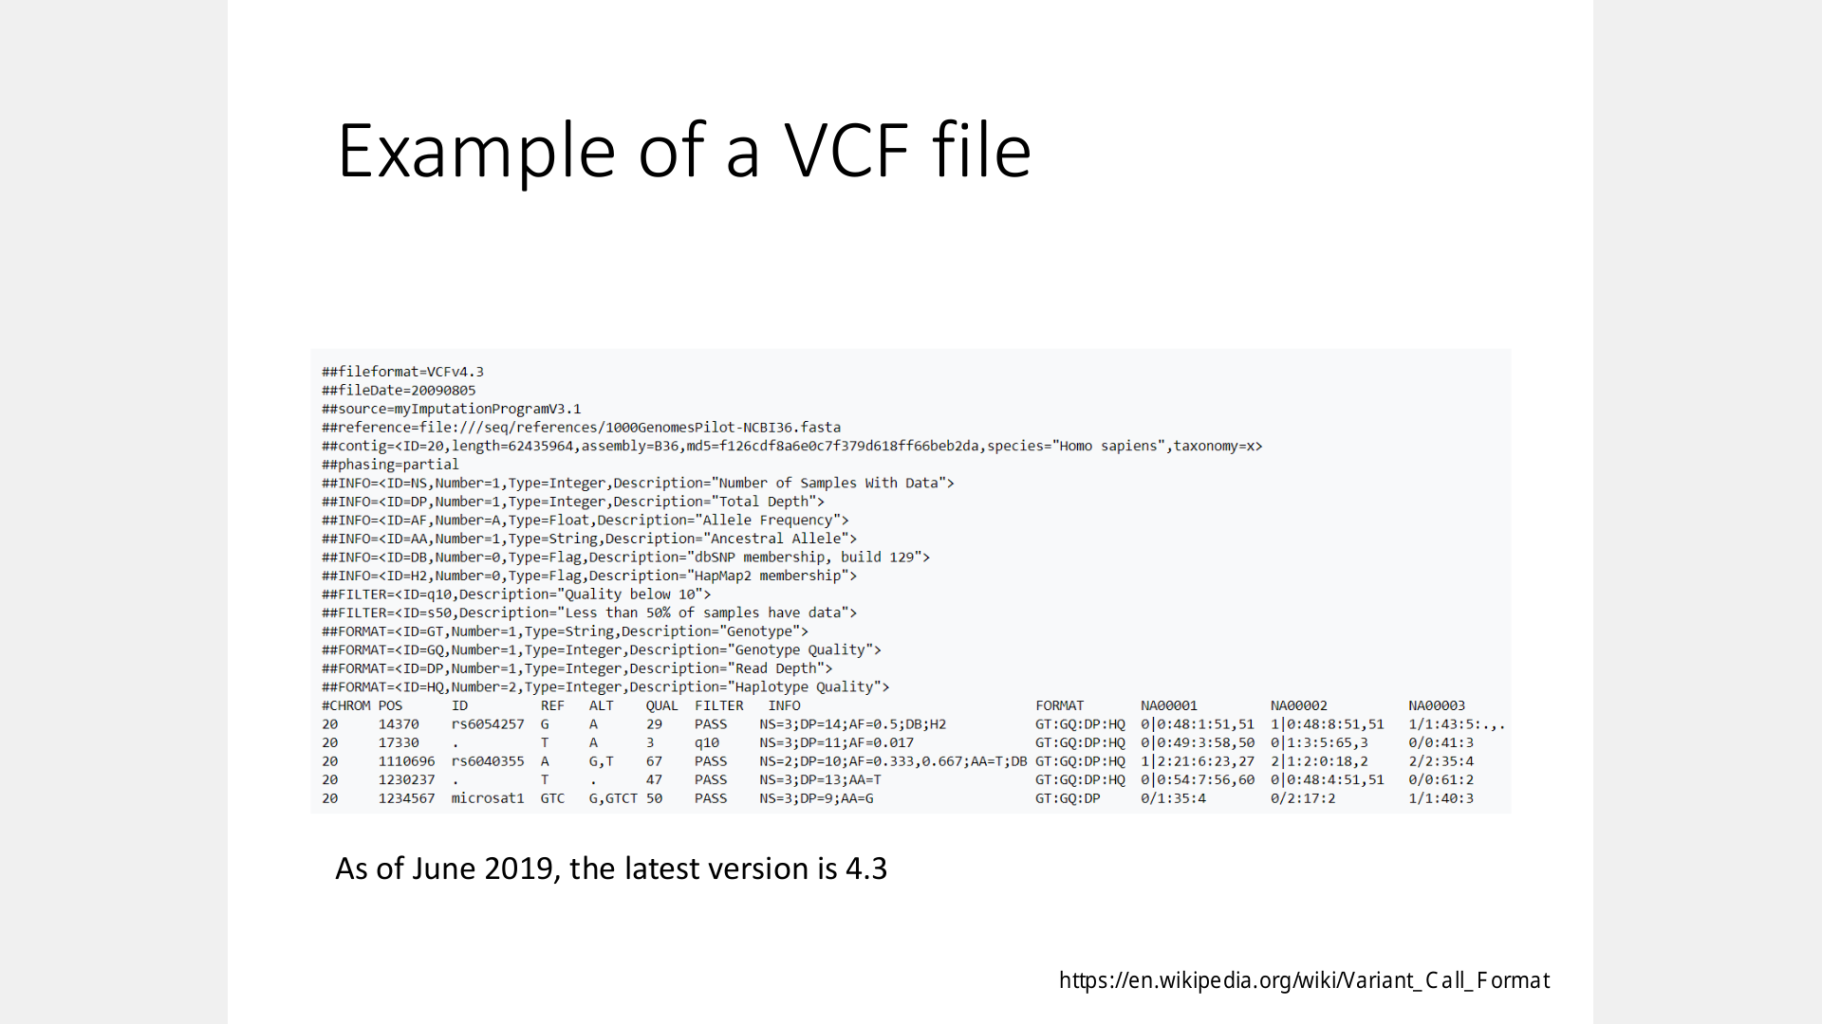

Slide 17
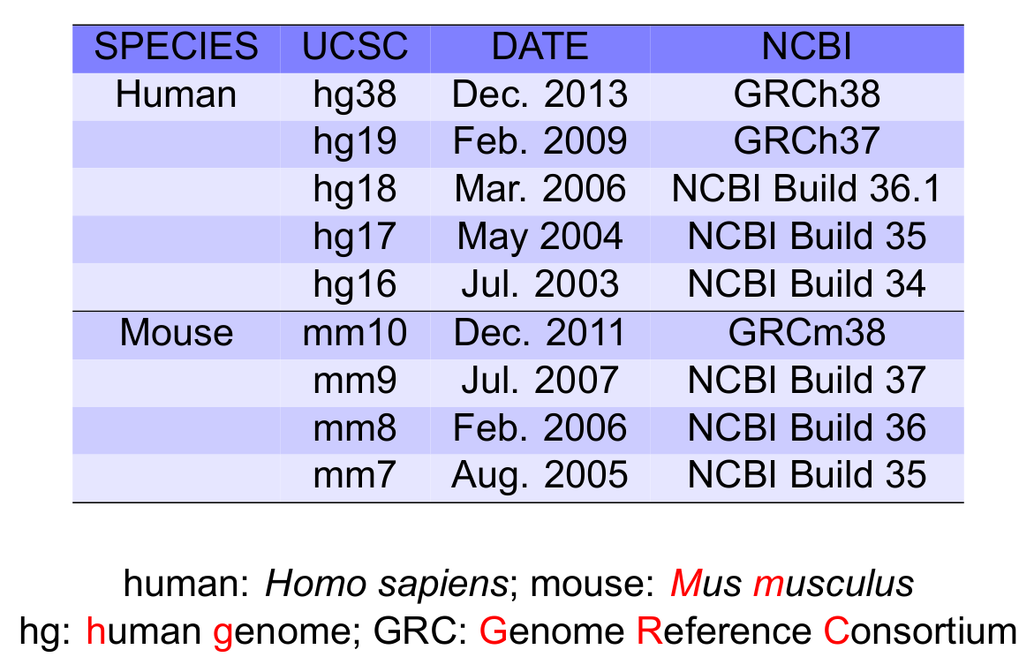
Genome build

Slide 18
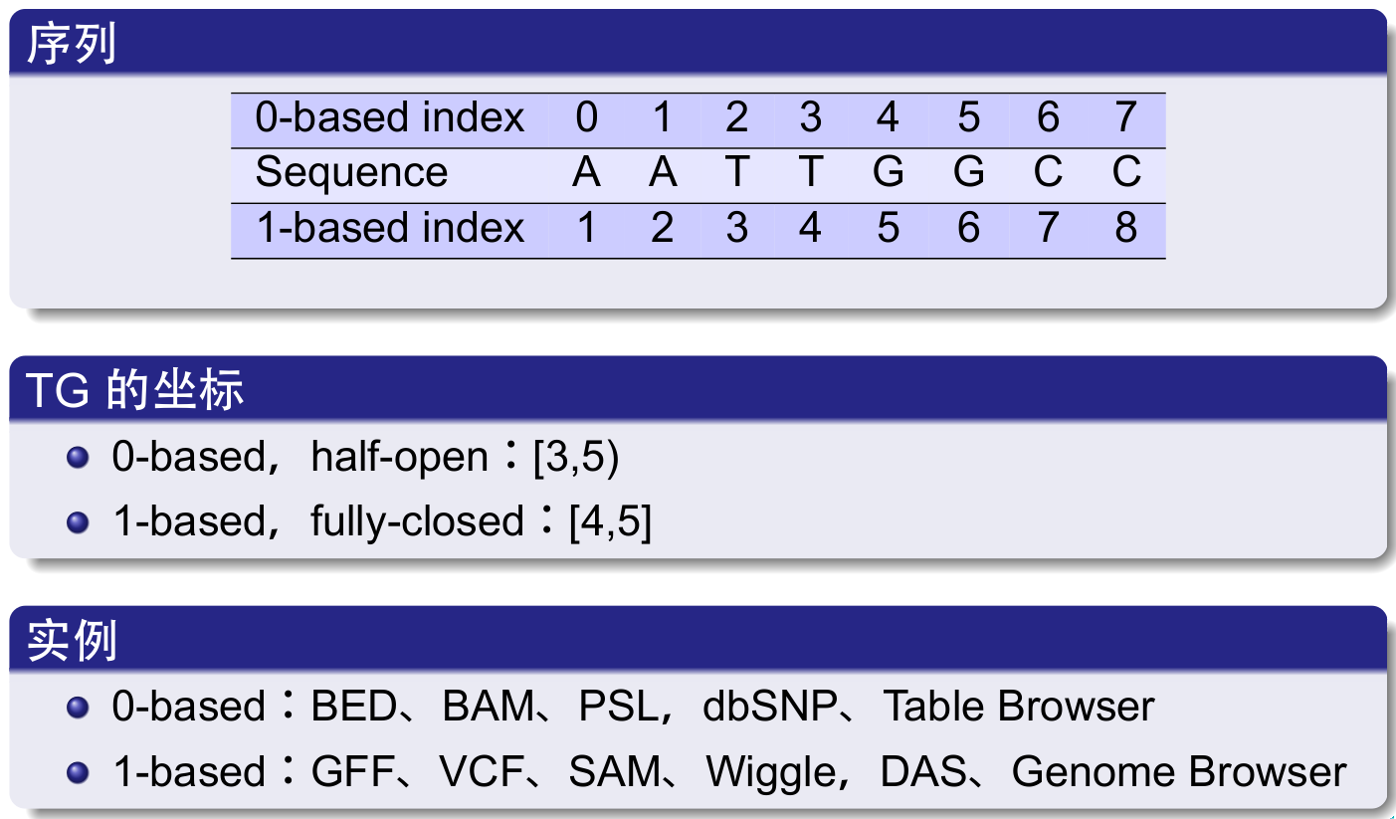
Coordinate system

Slide 19
Day 1: Variant calling

Slide 20
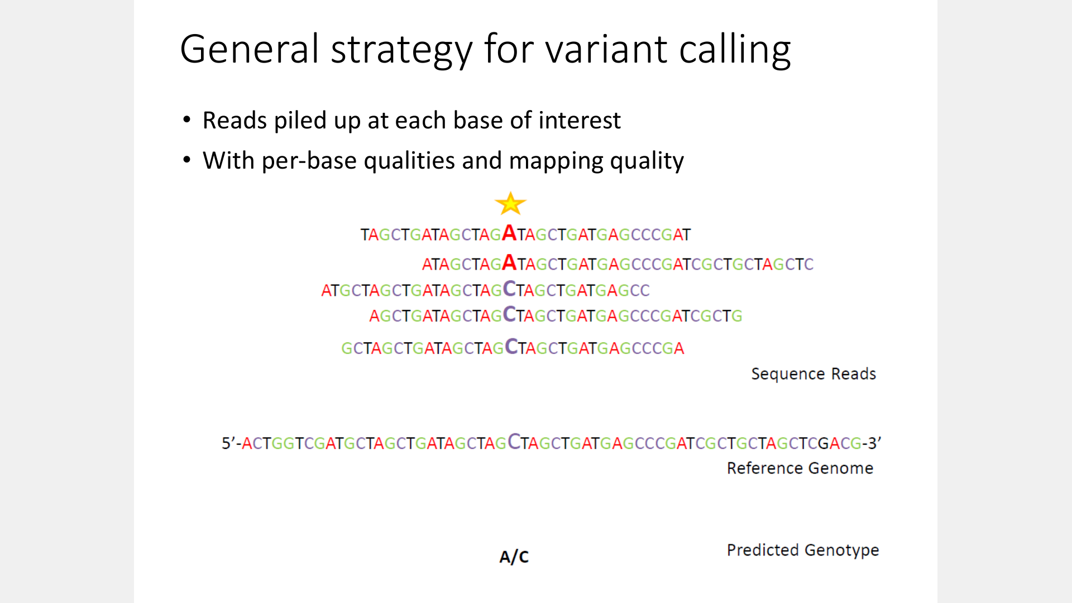

Slide 21
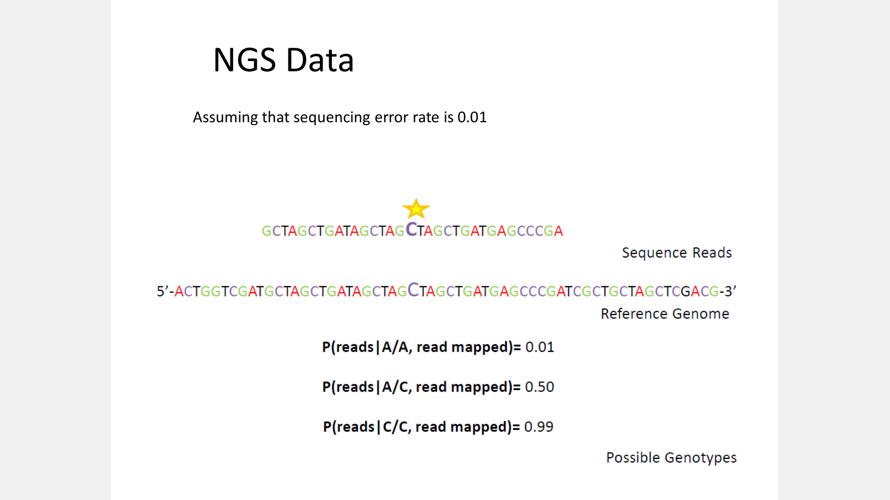

Slide 22
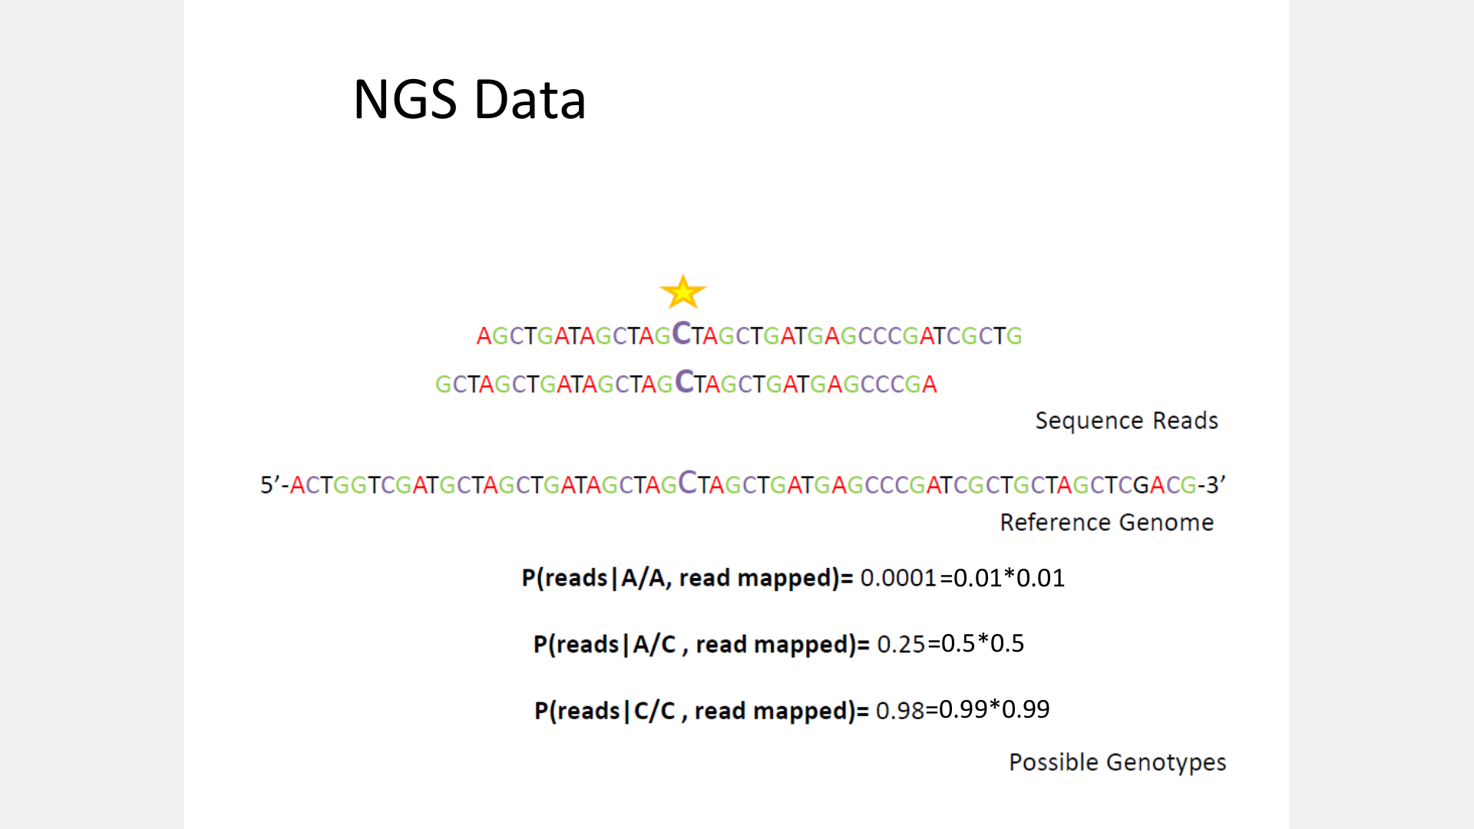

Slide 23
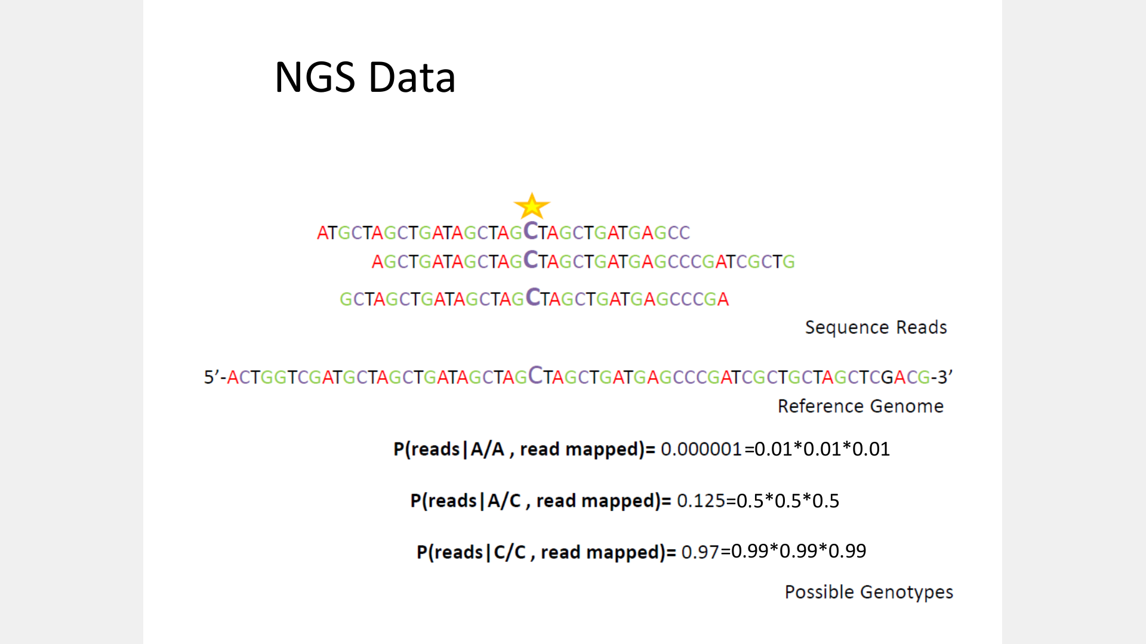

Slide 24
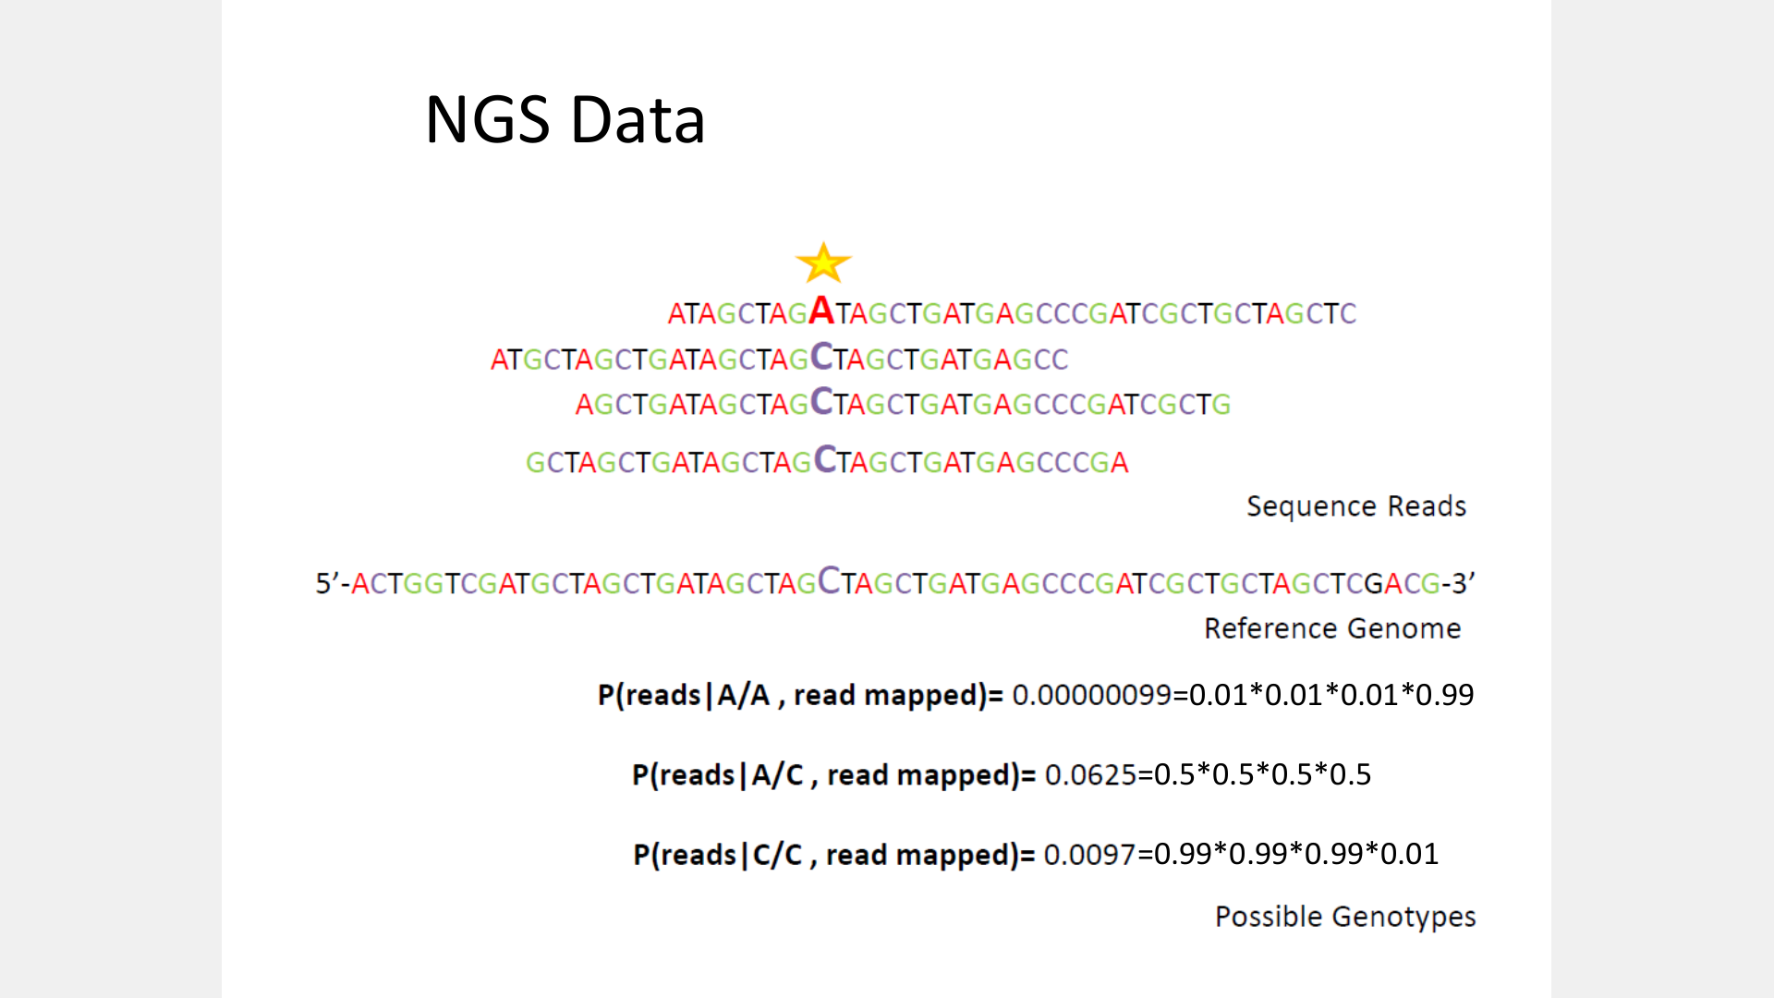

Slide 25
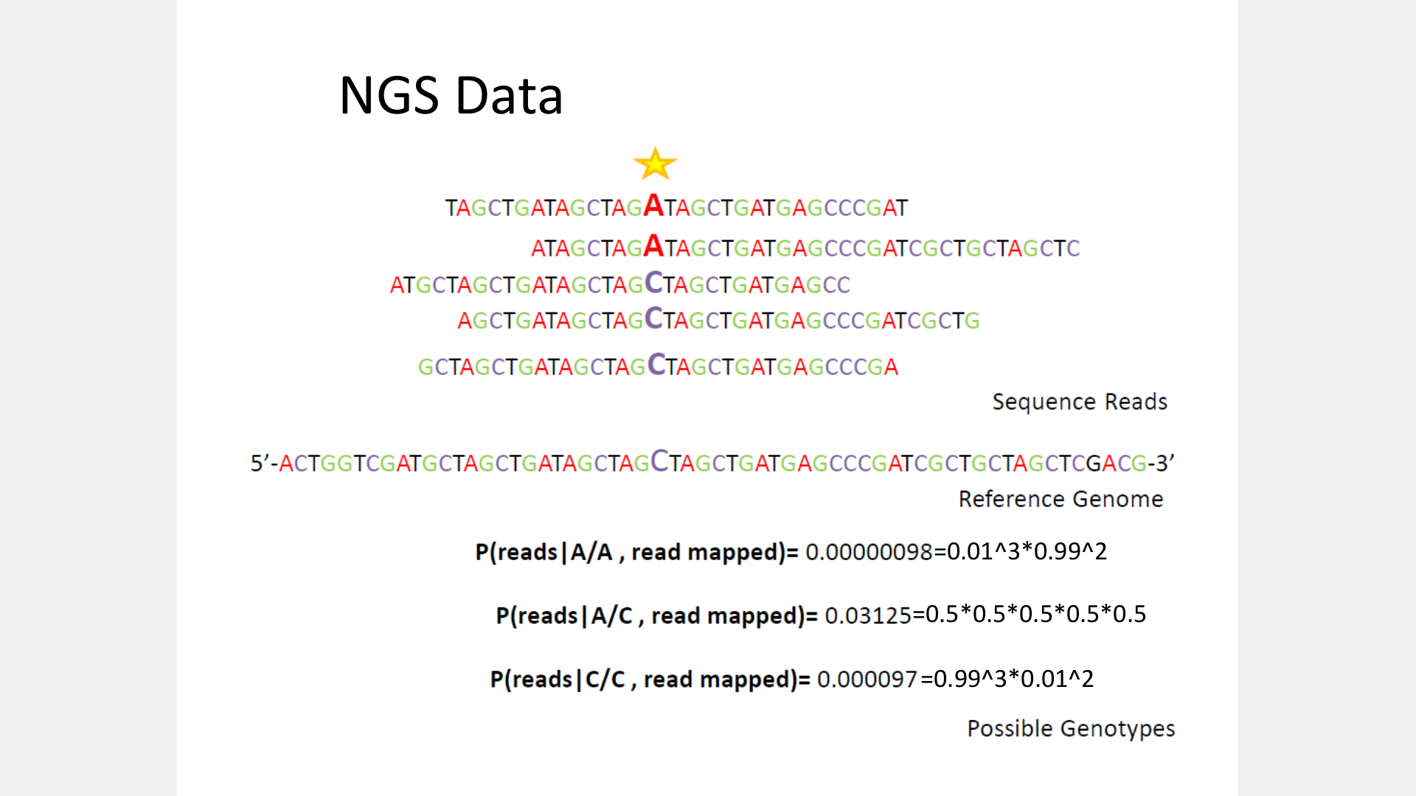

Slide 26
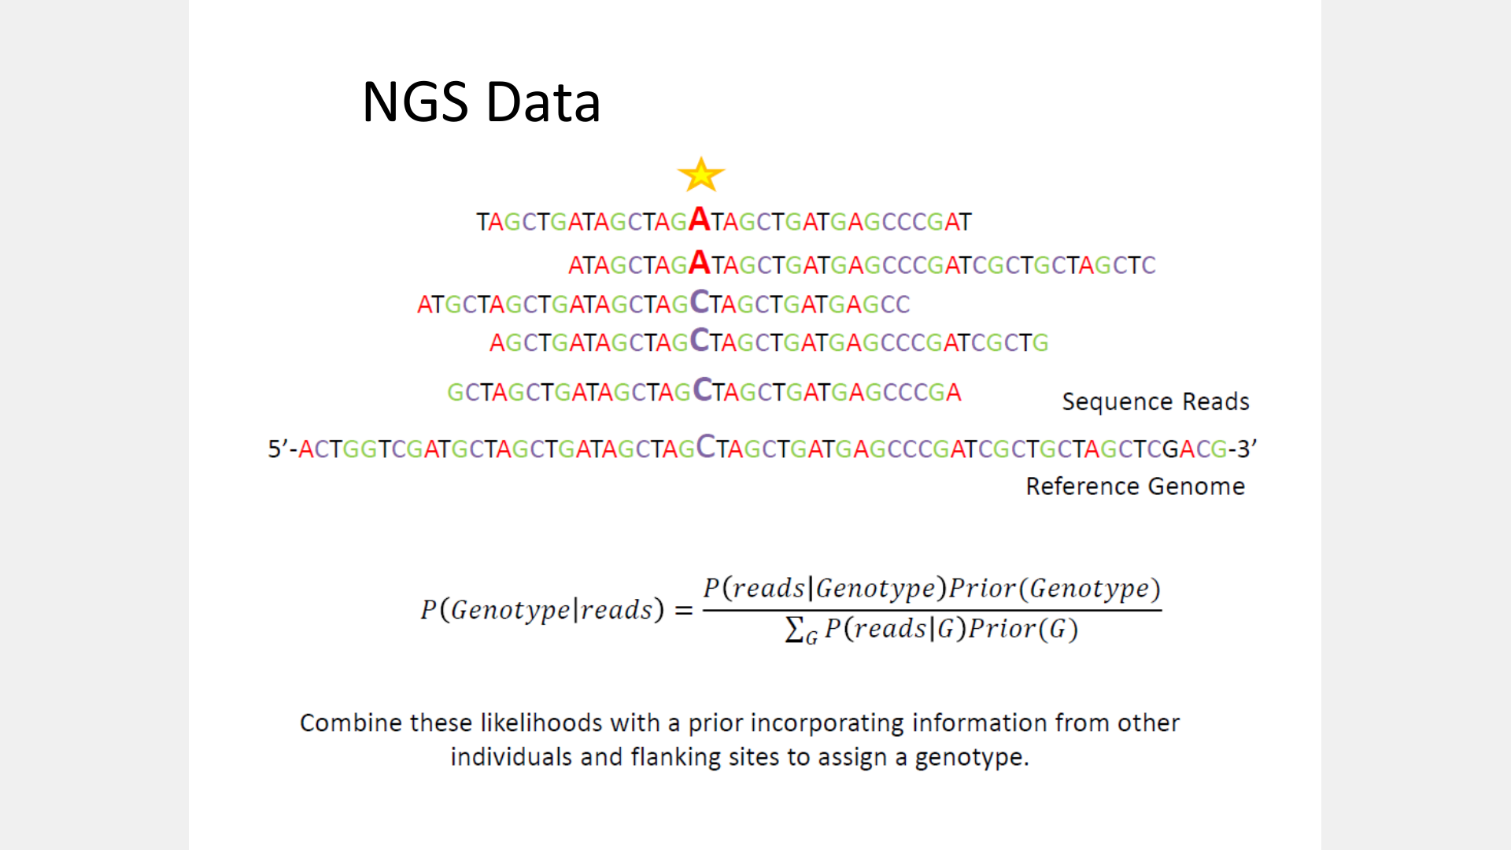

Slide 27
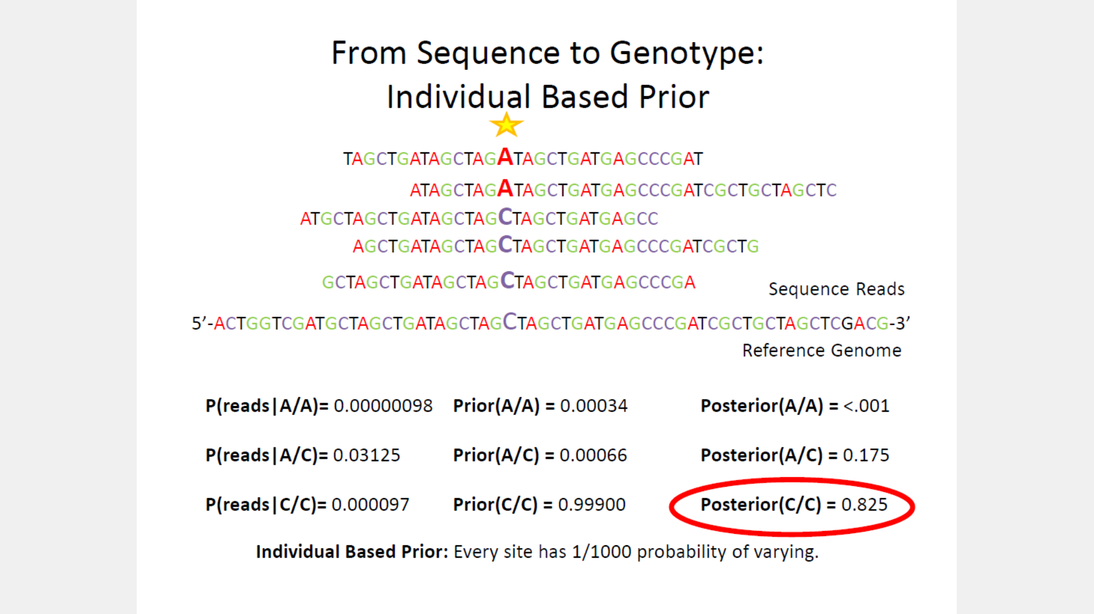

Slide 28
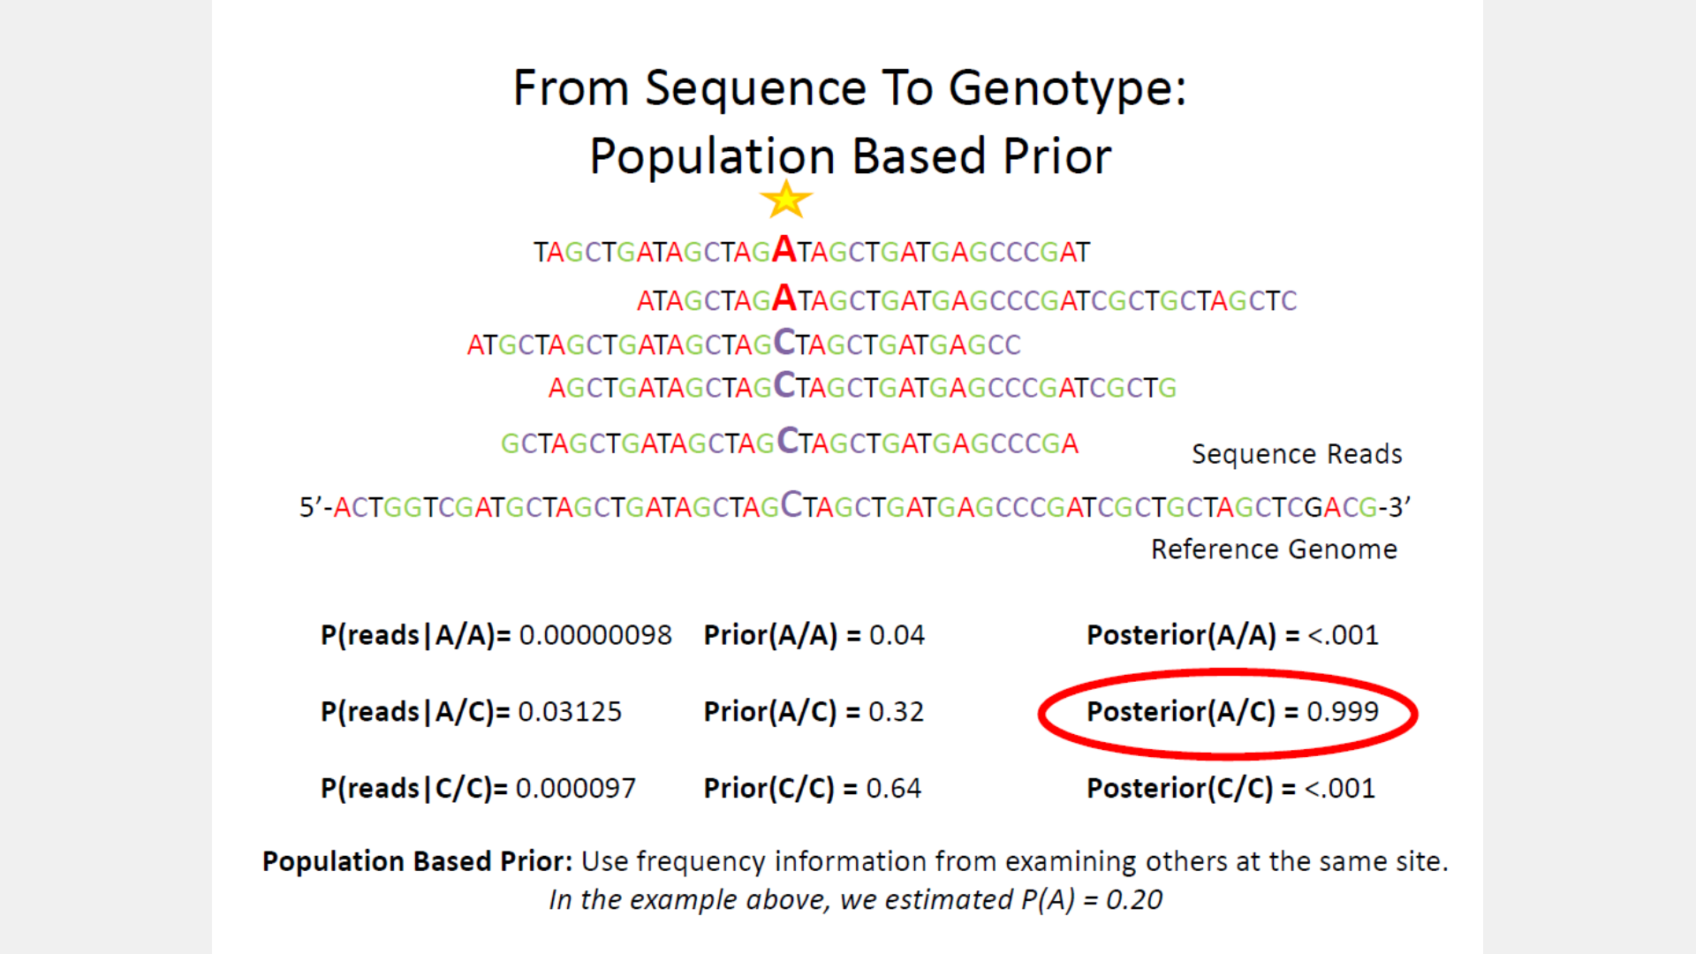

Slide 29
Day 2: Alignment of sequencing data
Dynamic programming
BWT

Slide 30
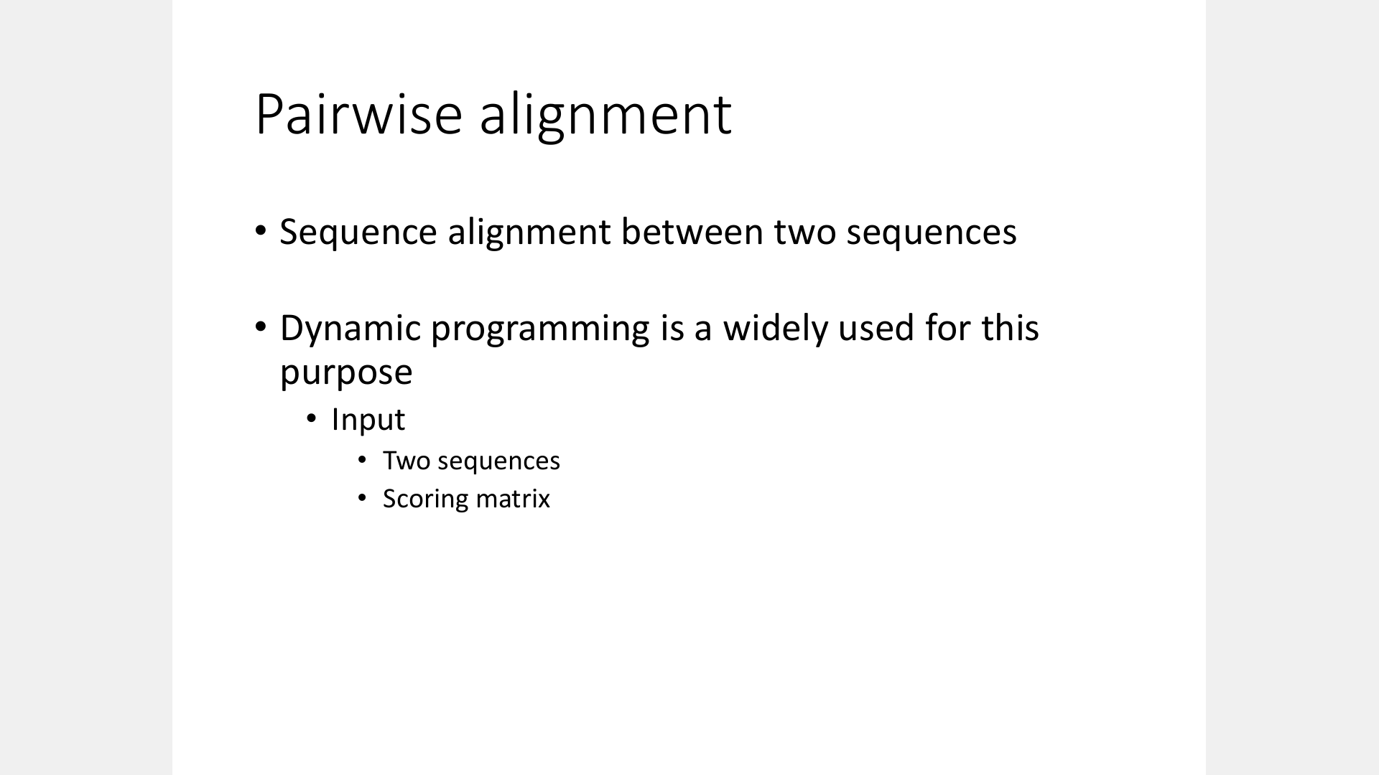

Slide 31
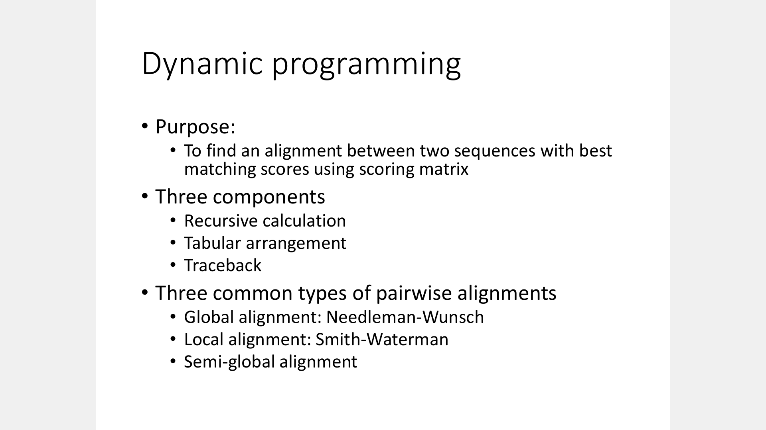

Slide 32
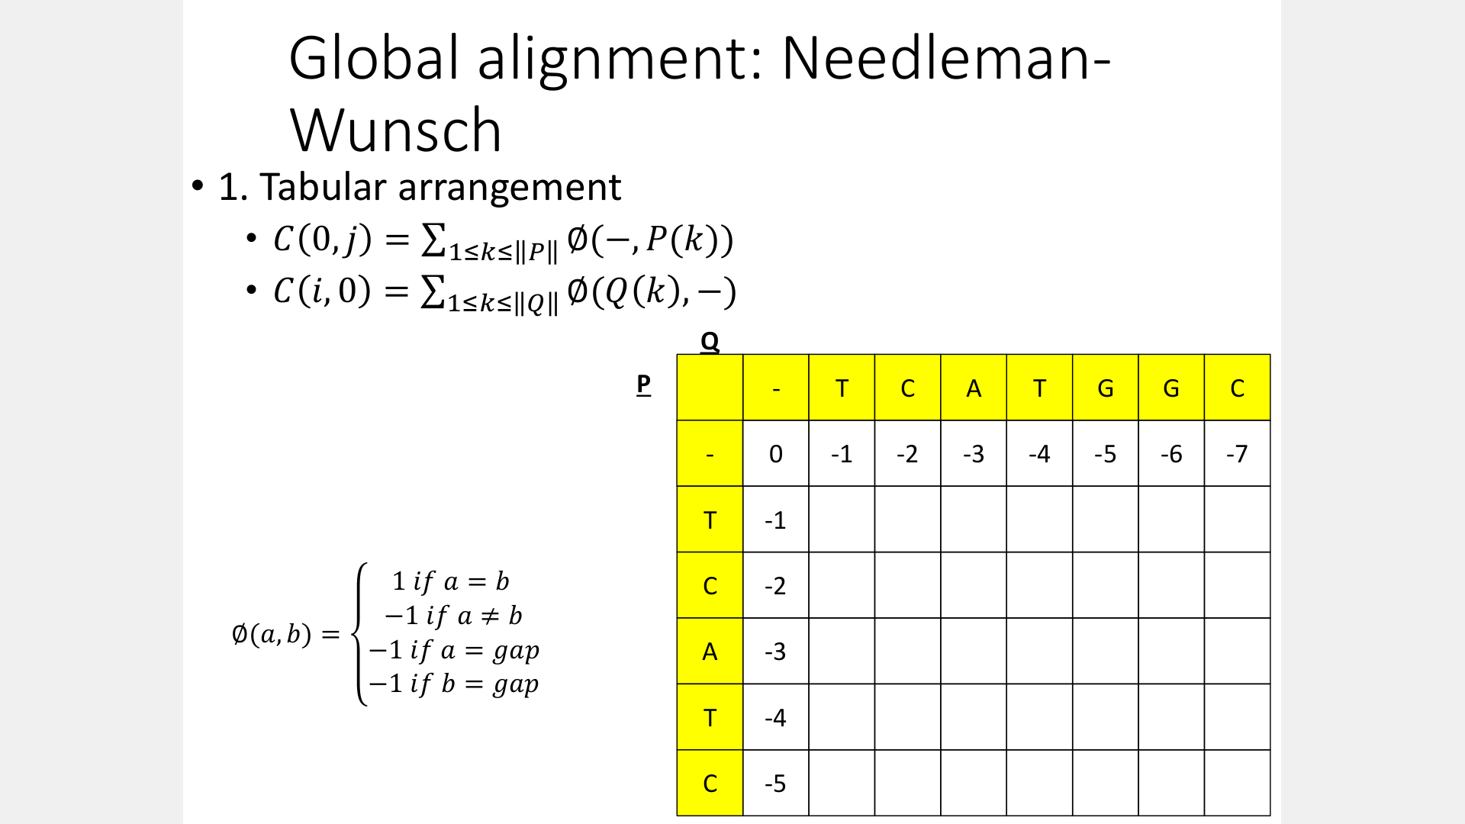

Slide 33
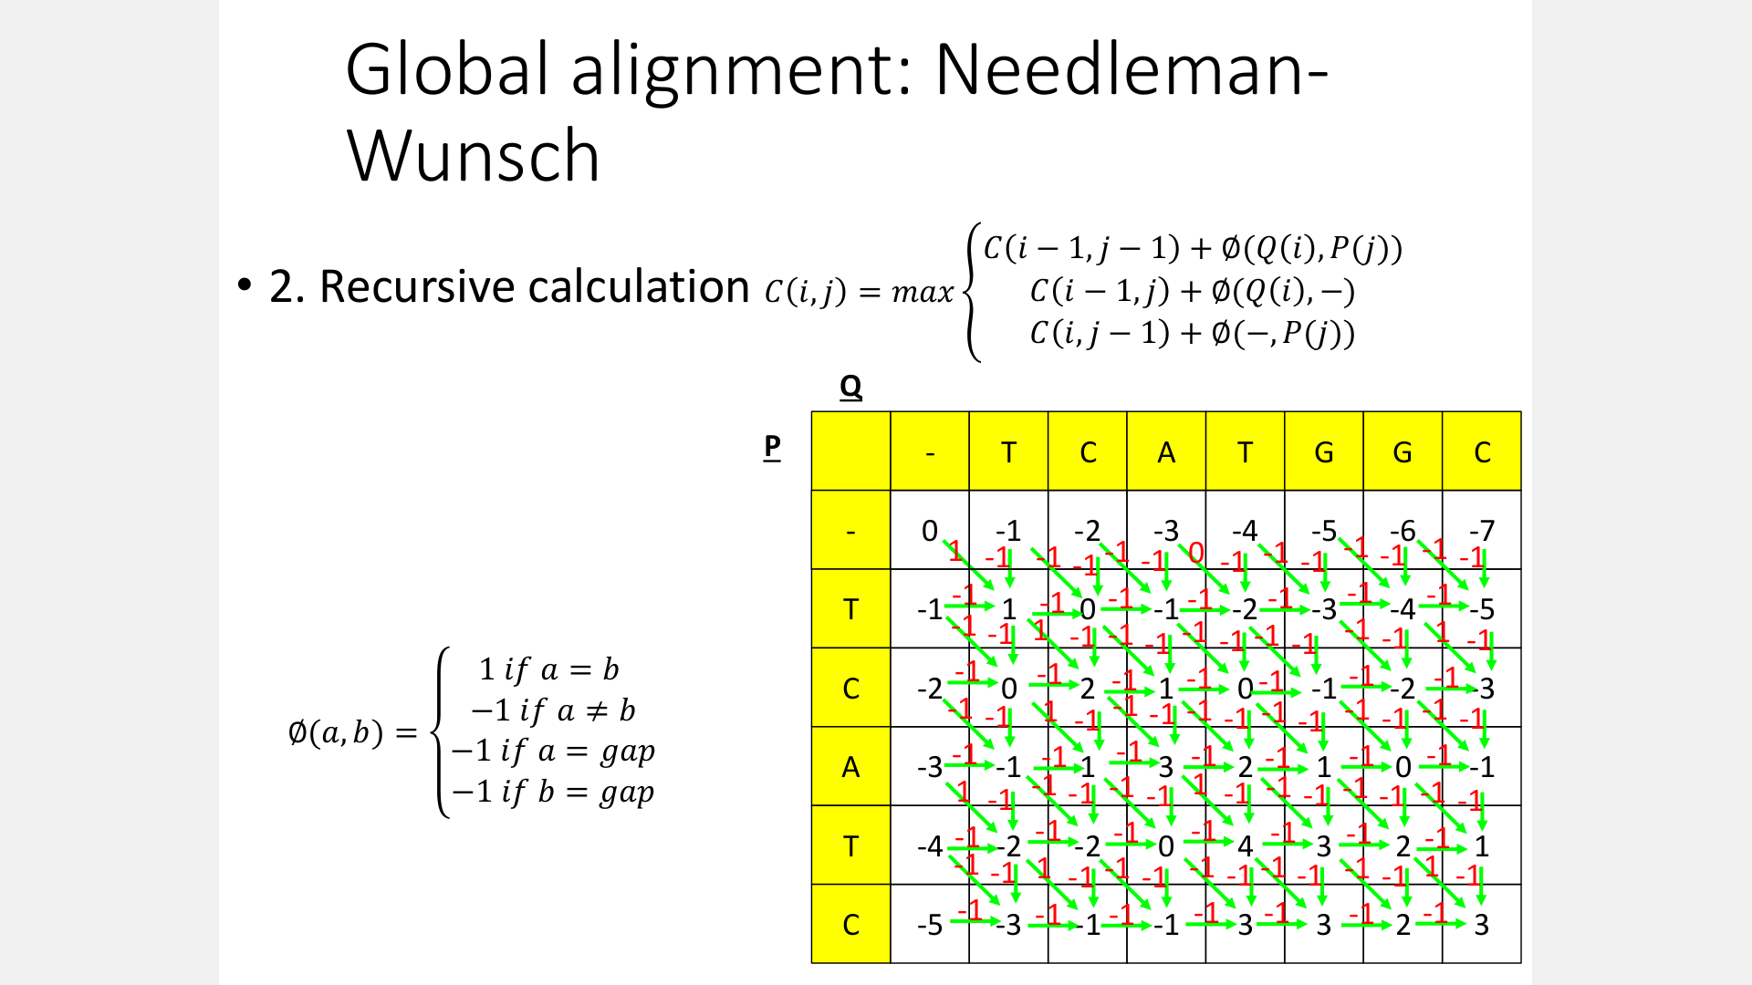

Slide 34
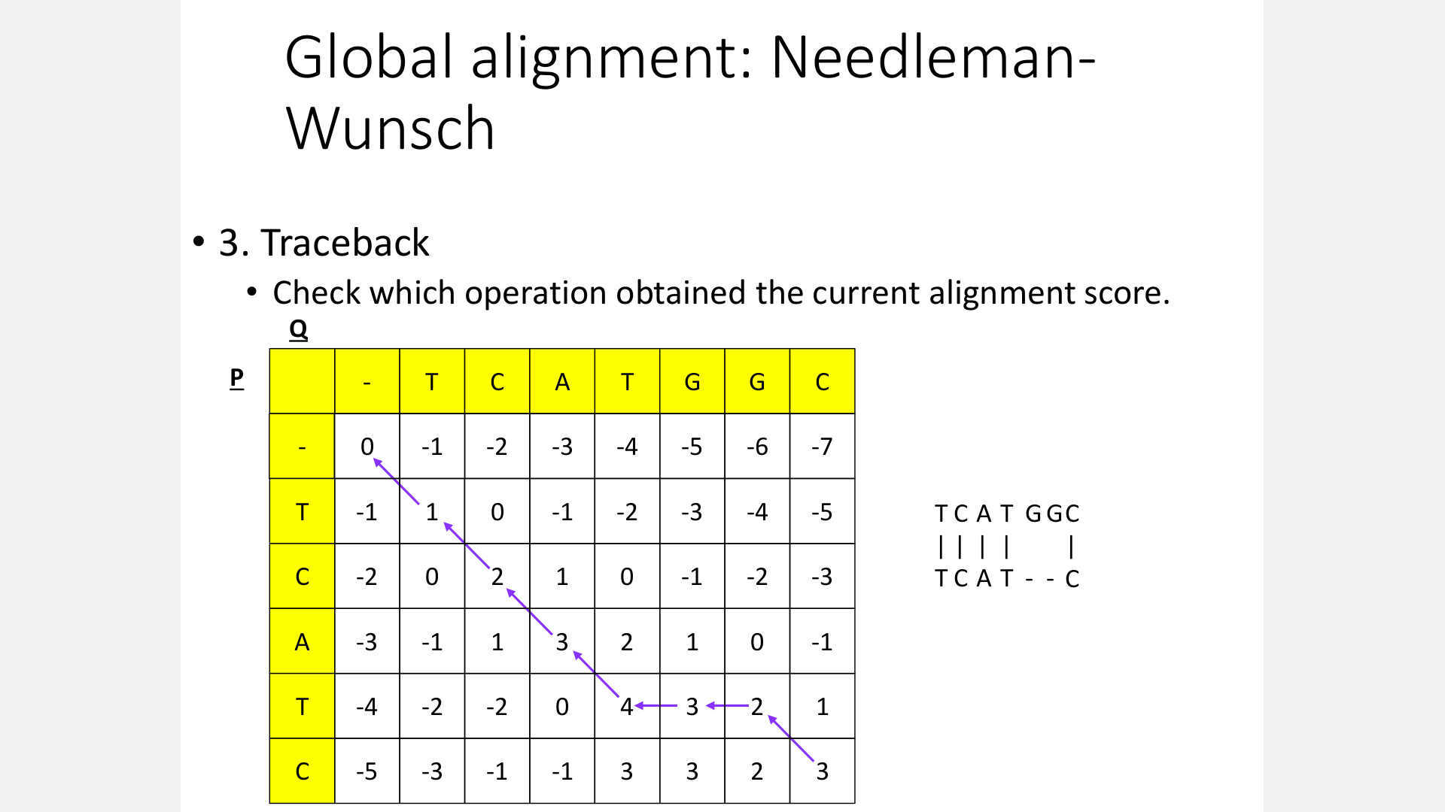

Slide 35
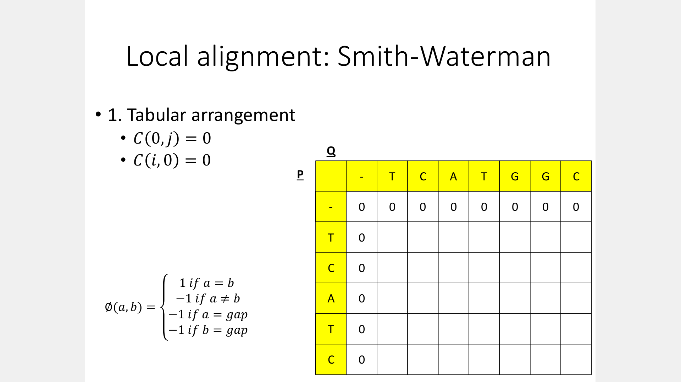

Slide 36
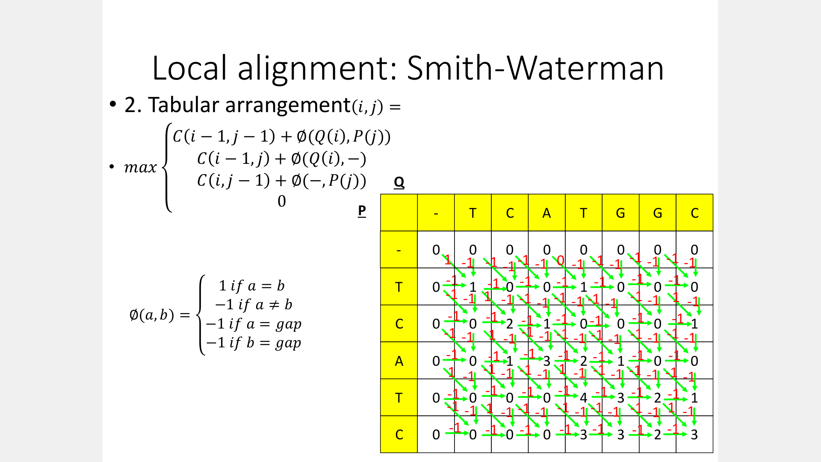

Slide 37
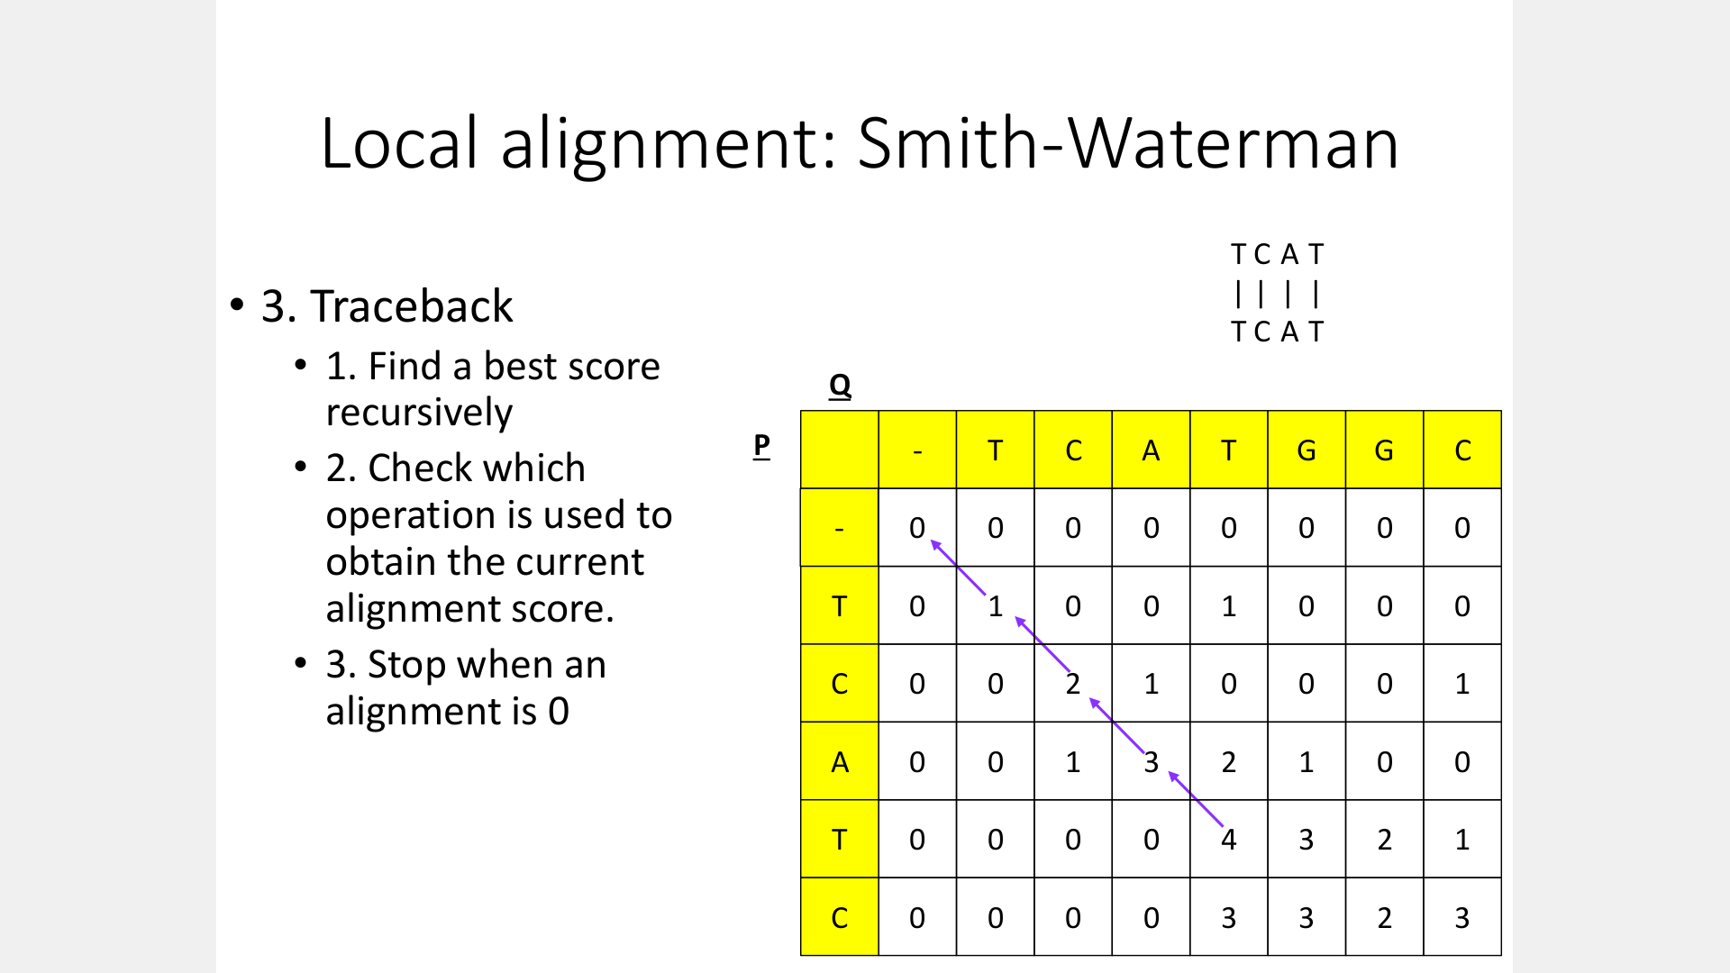

Slide 38
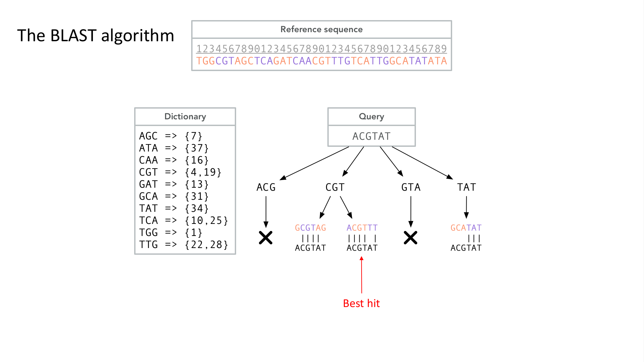

Slide 39
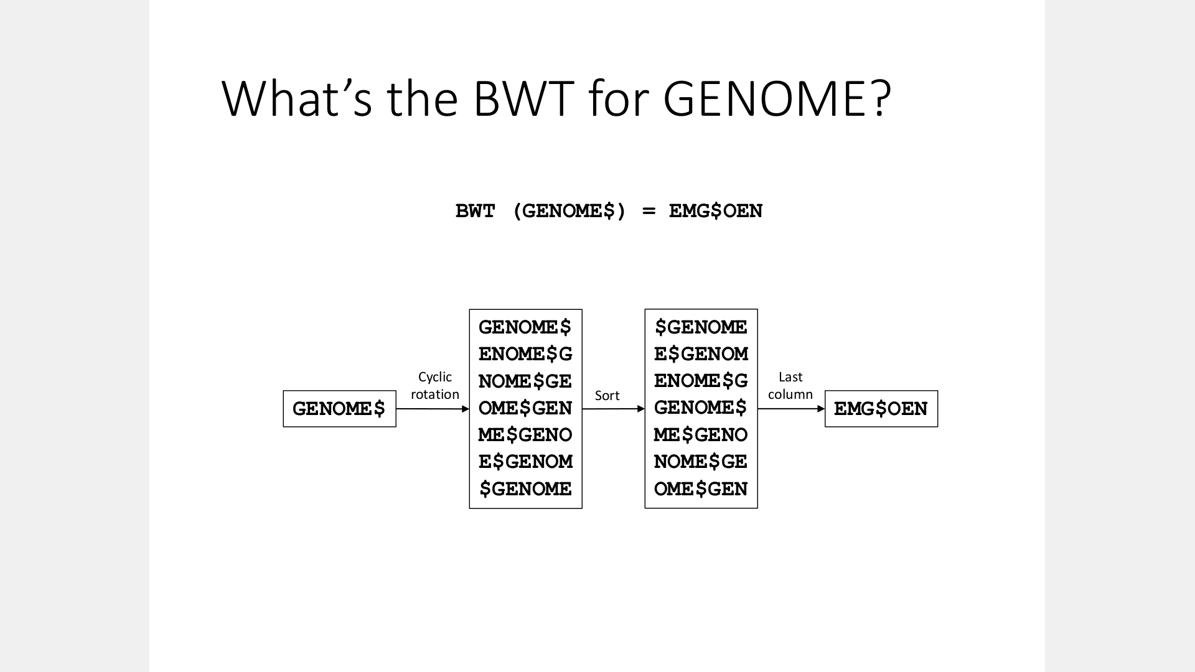

Slide 40
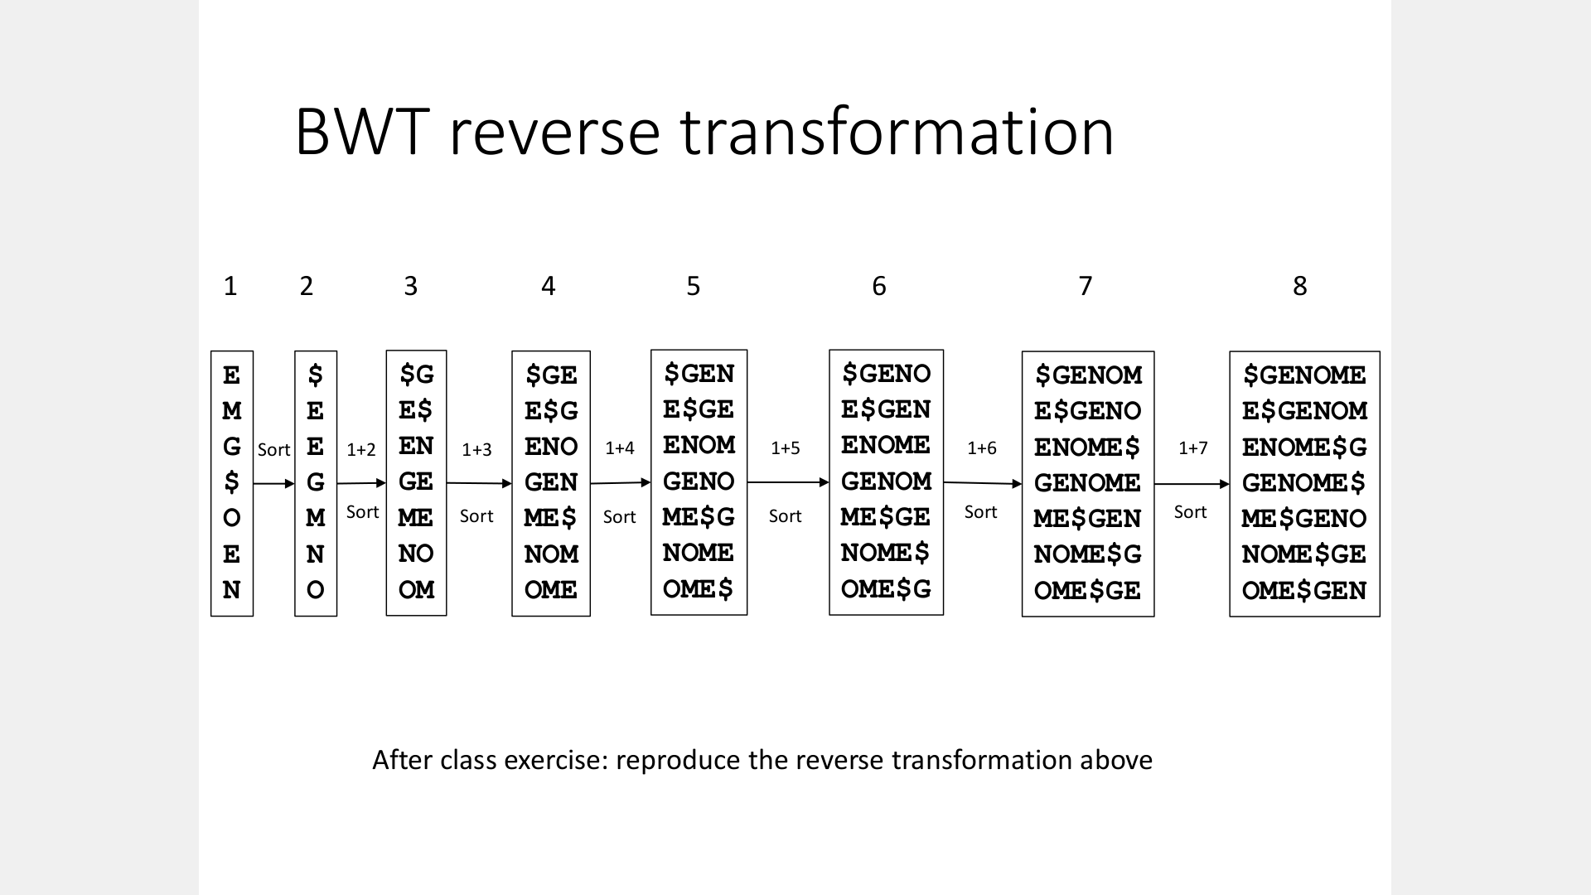

Slide 41
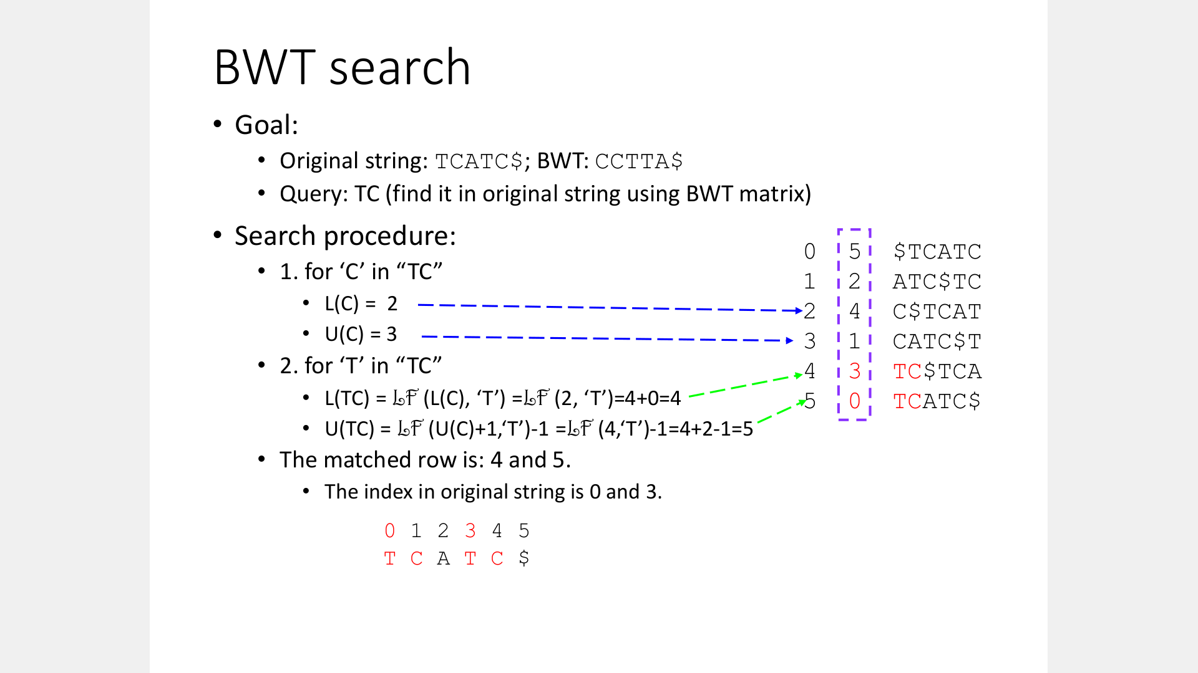

Slide 42
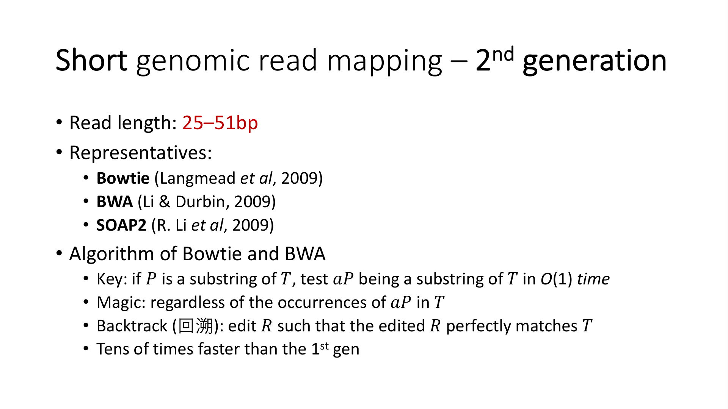

Slide 43
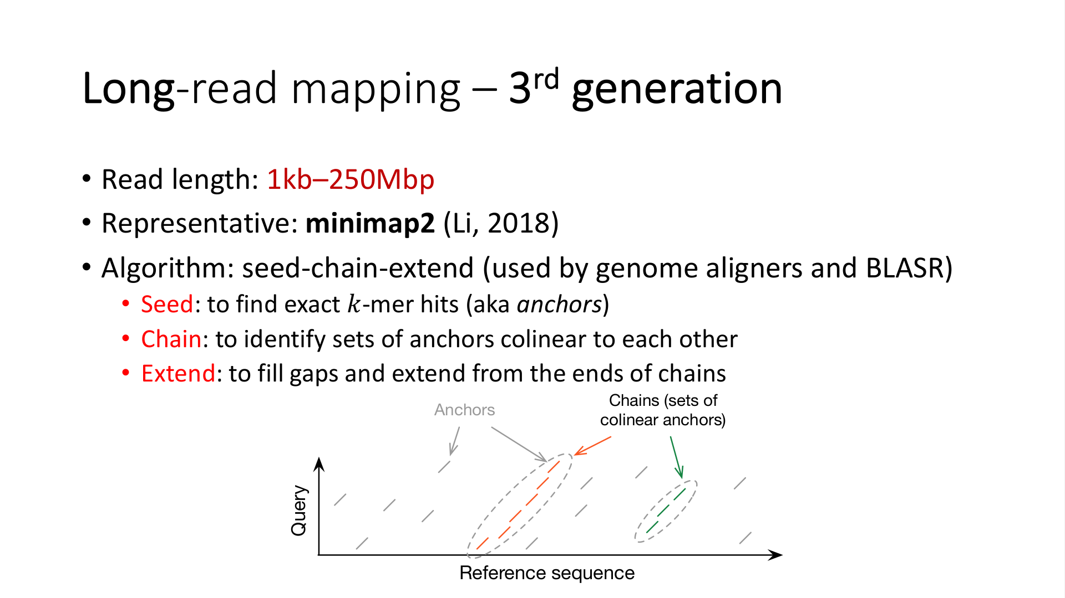

Slide 44
Day 2: genome assembly

Slide 45
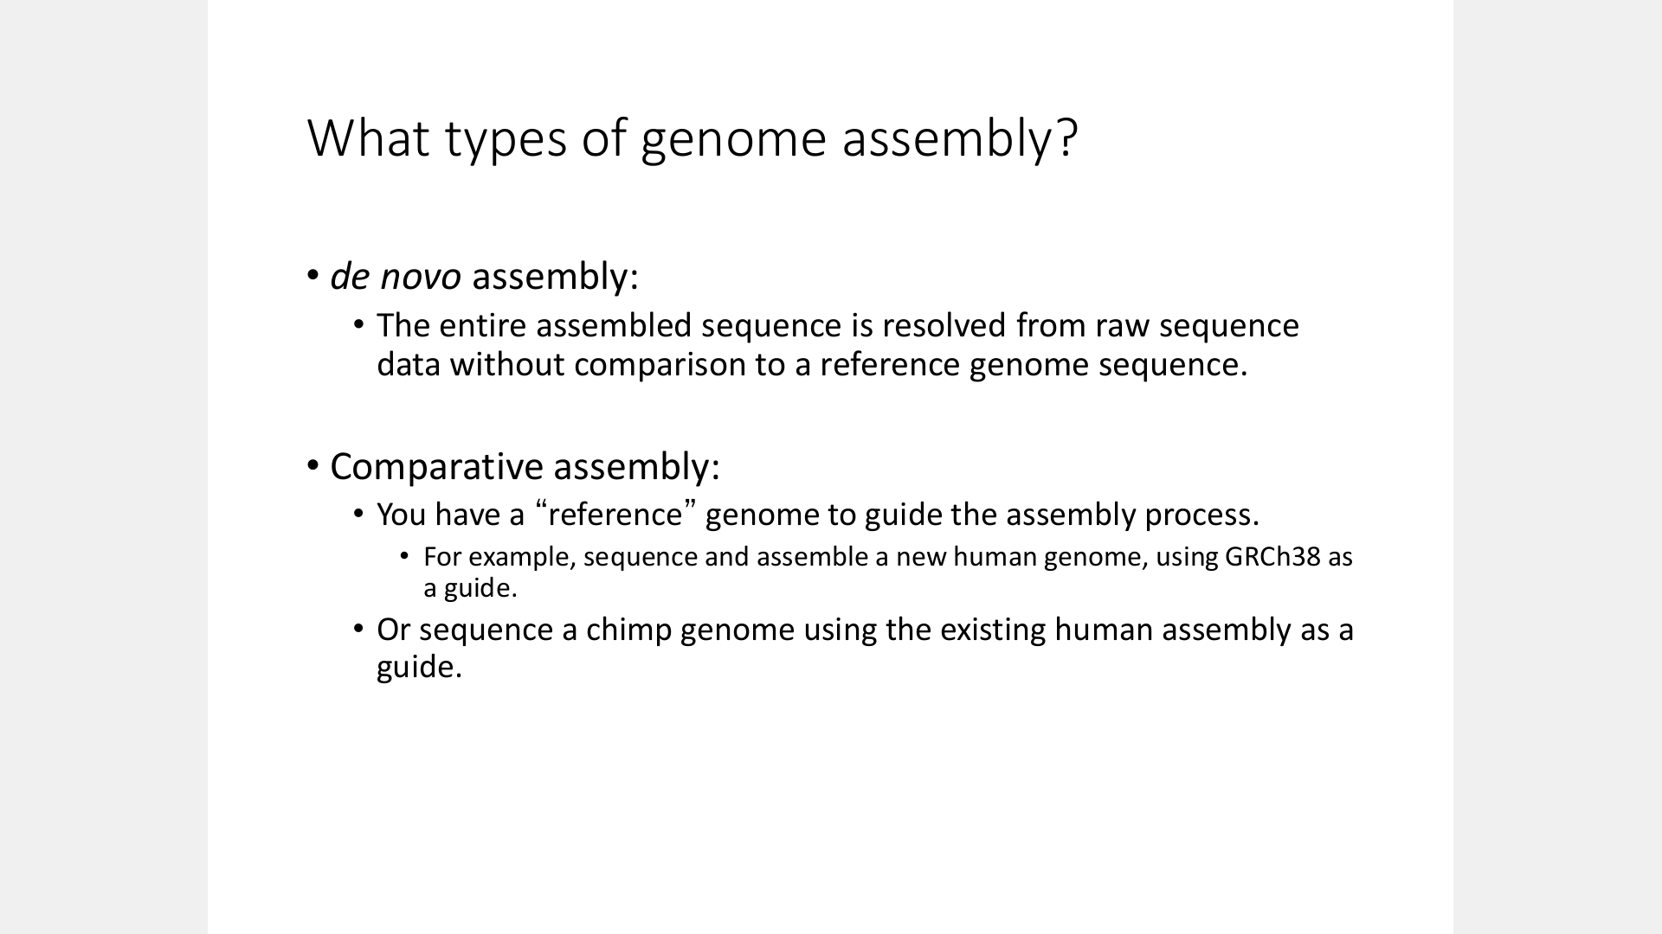

Slide 46
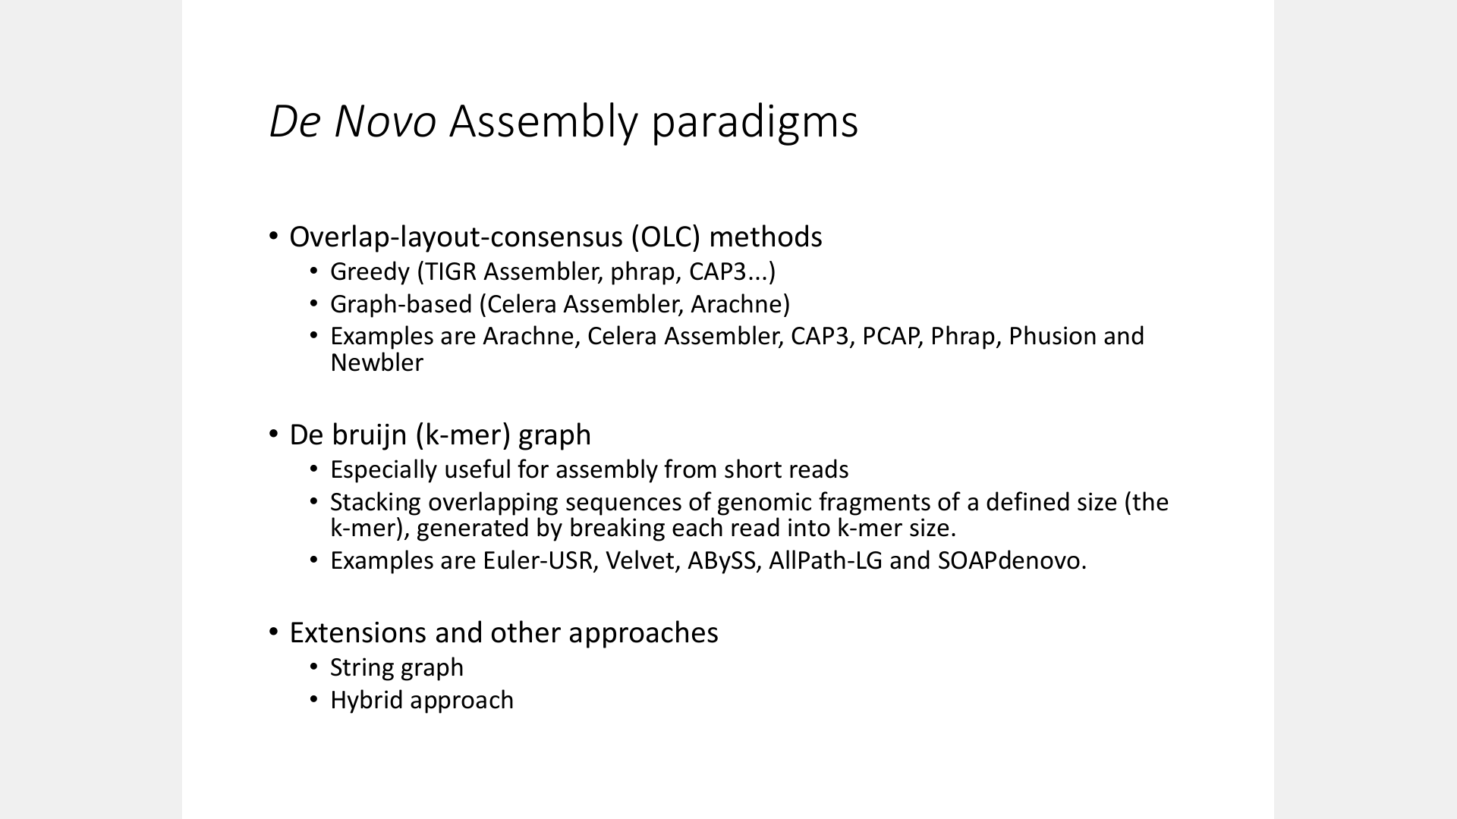

Slide 47
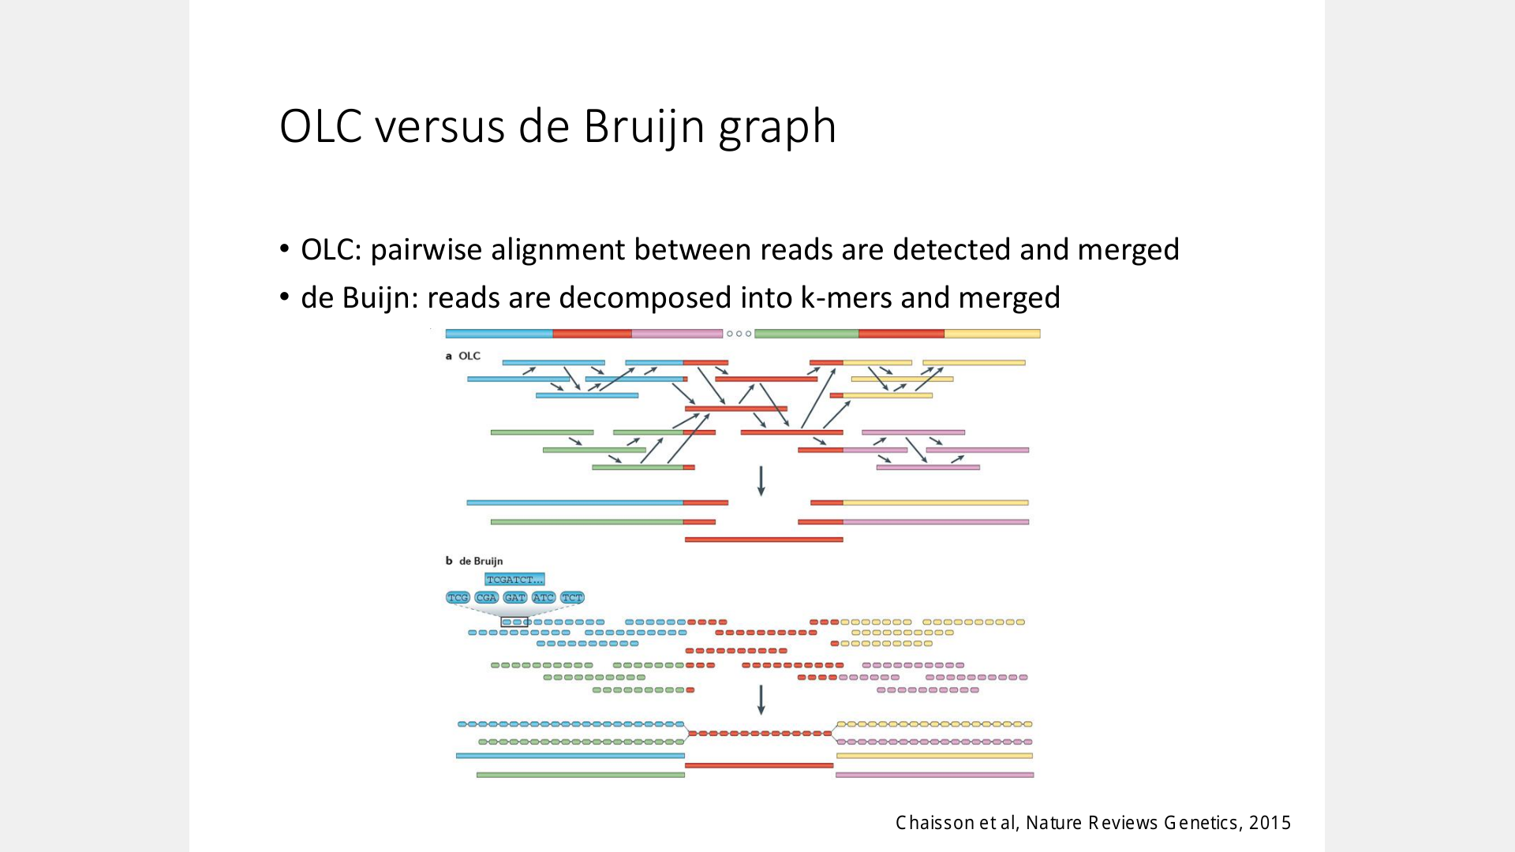

Slide 48
Day 3: Detection of structural variants

Slide 49
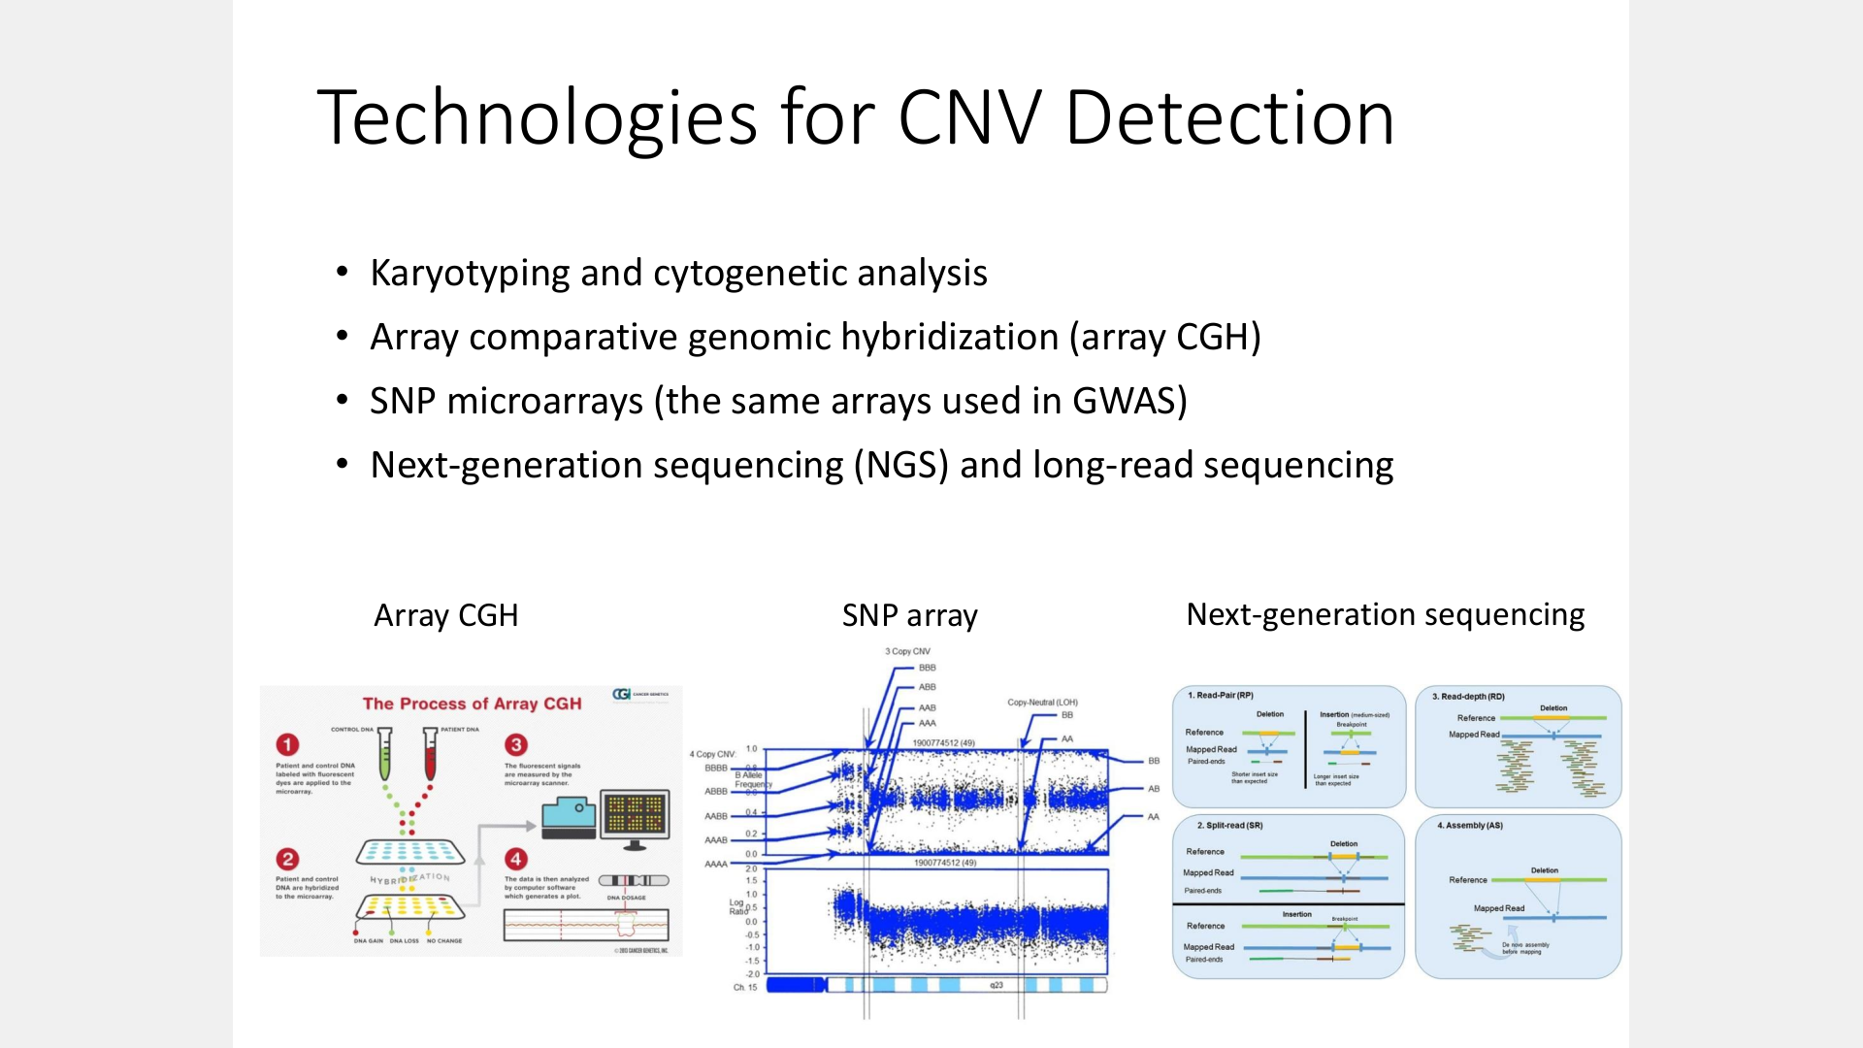

Slide 50
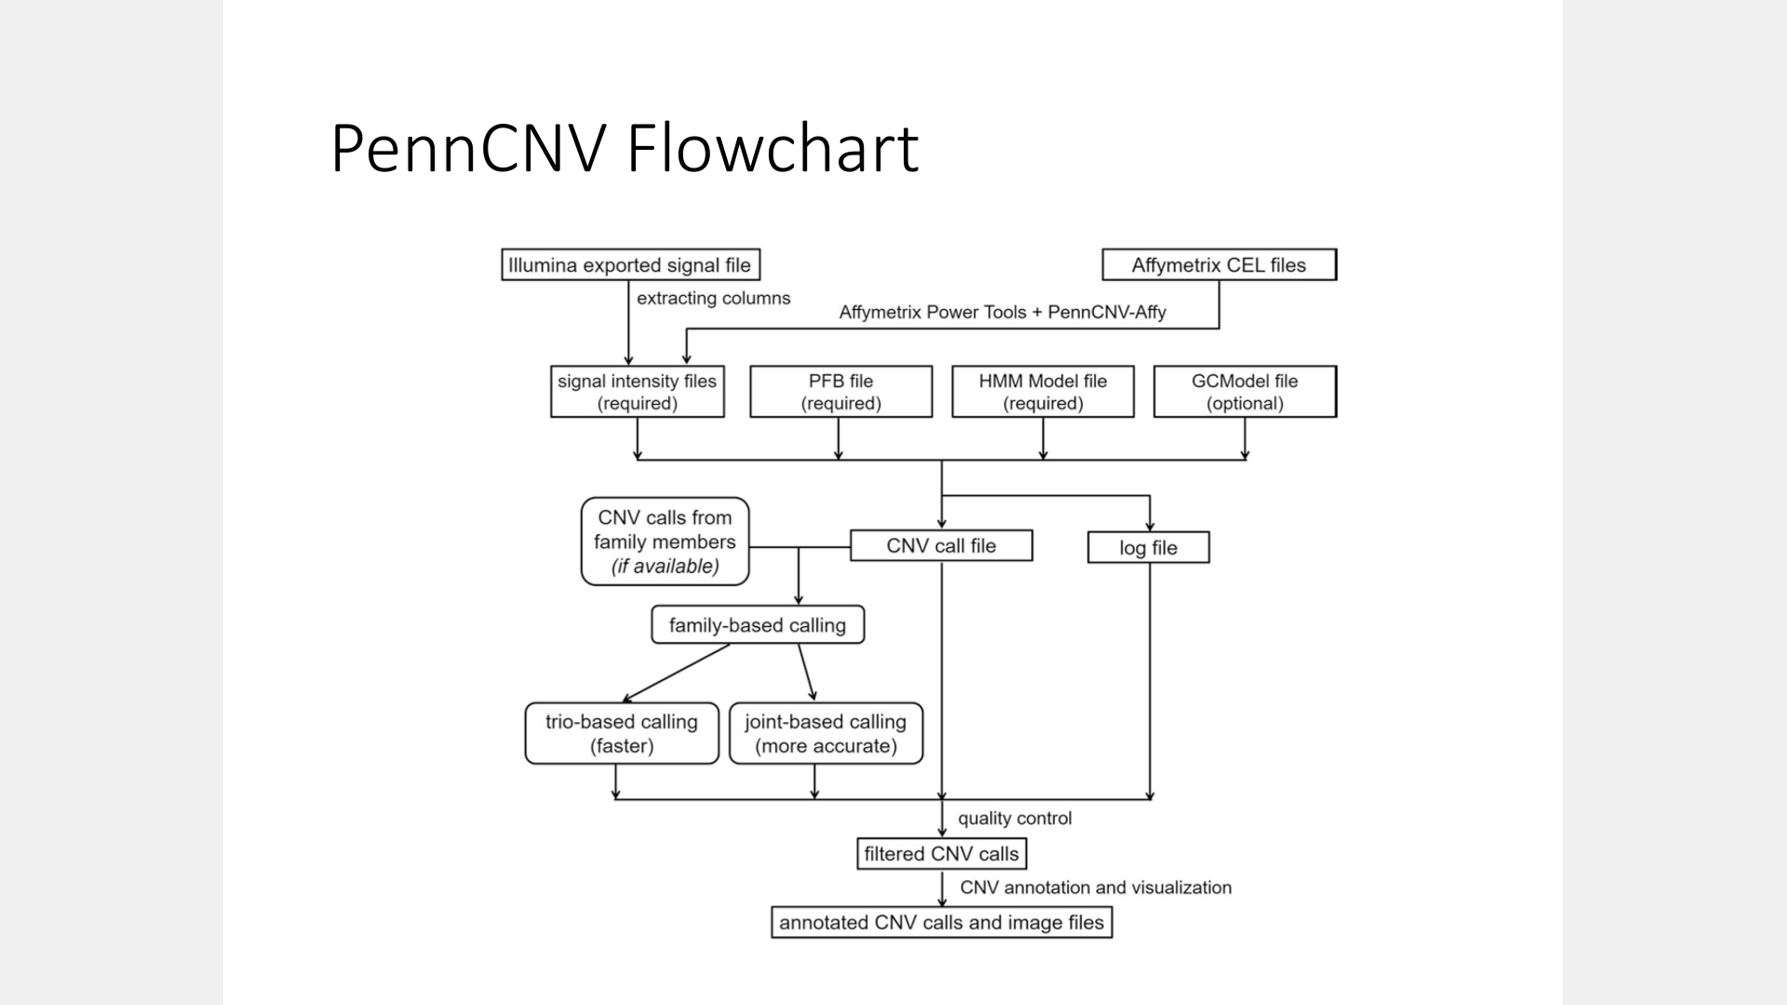

Slide 51
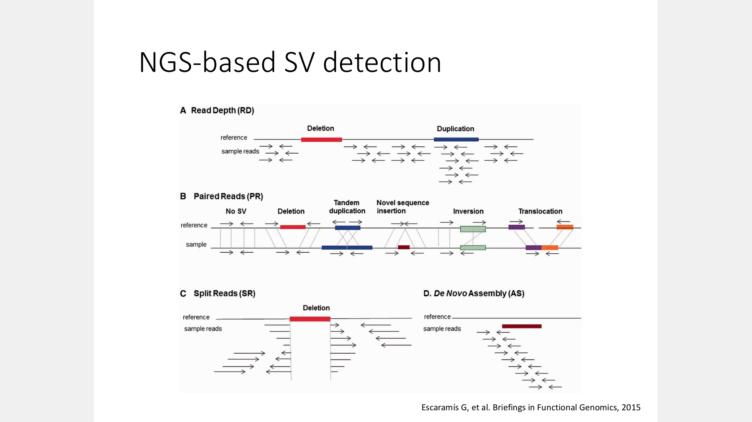

Slide 52
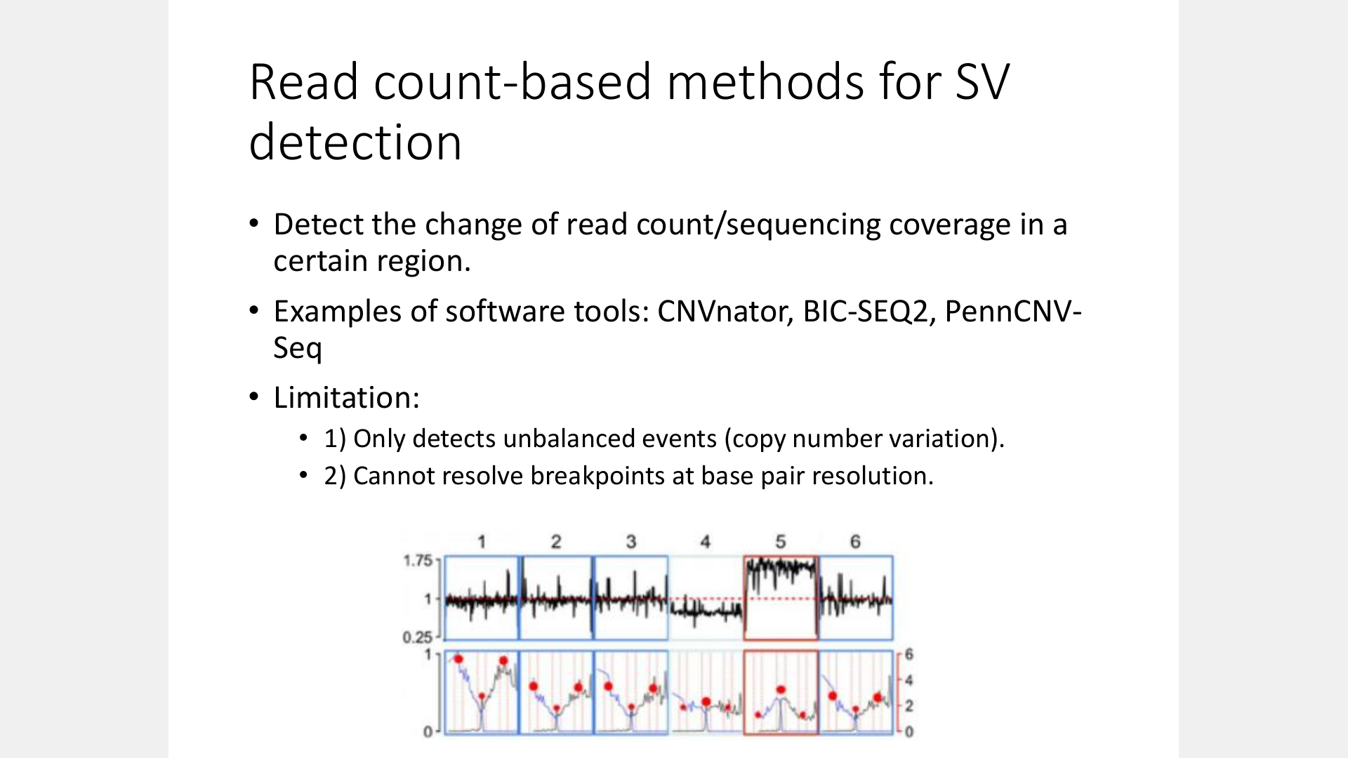

Slide 53
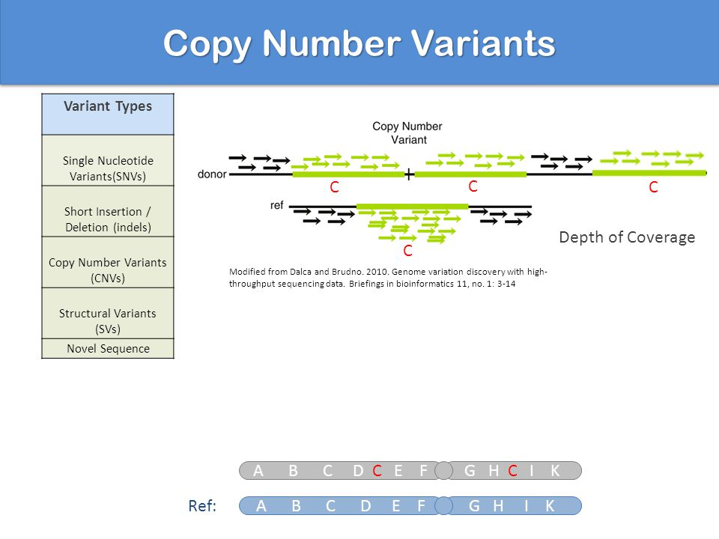

Slide 54
Day 3: Phenotype-driven variant annotation/interpretation

Slide 55
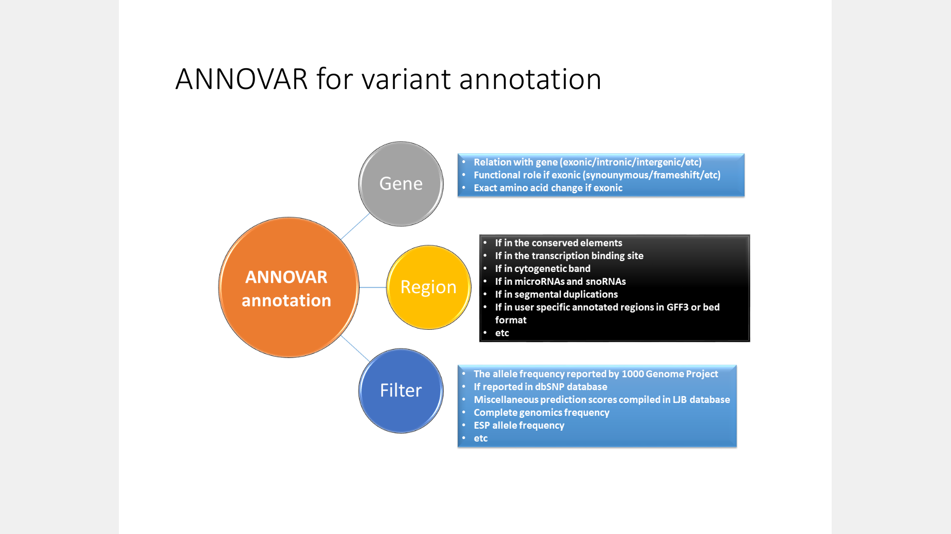

Slide 56
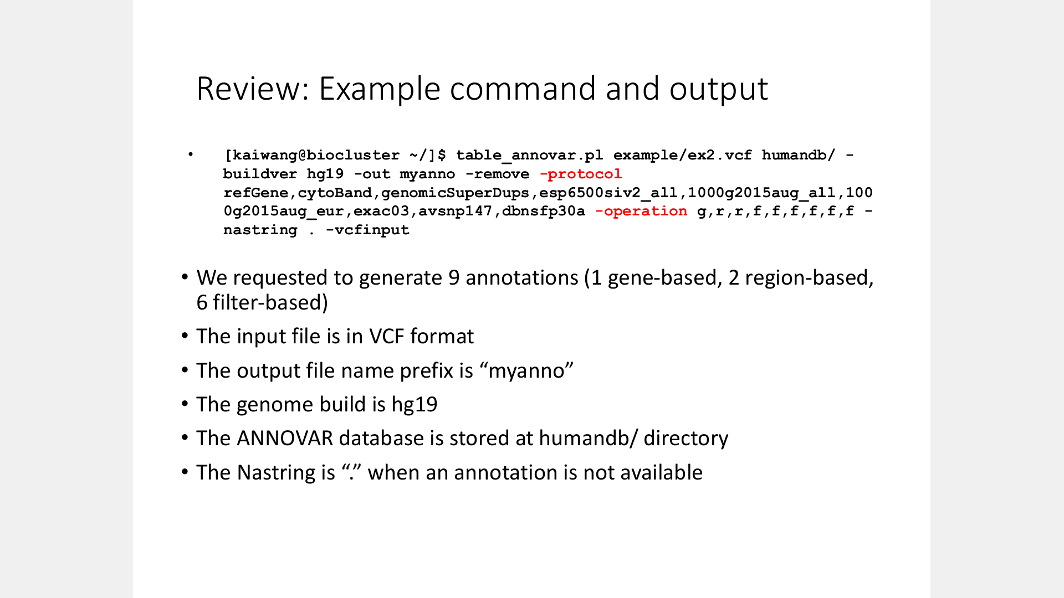

Slide 57
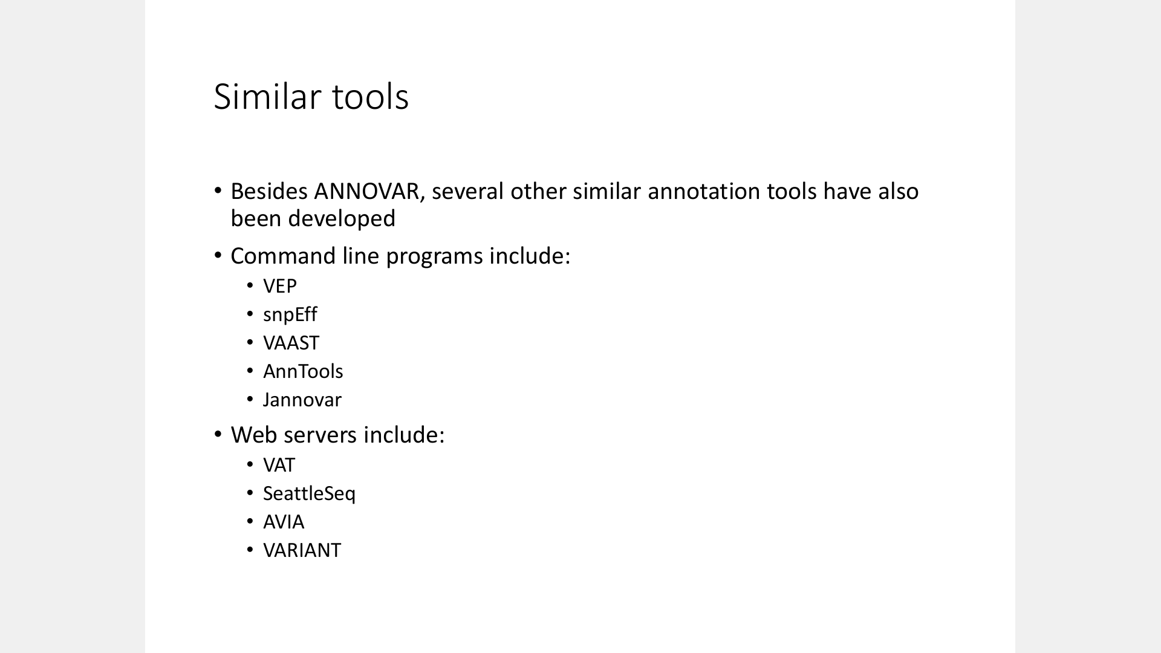

Slide 58
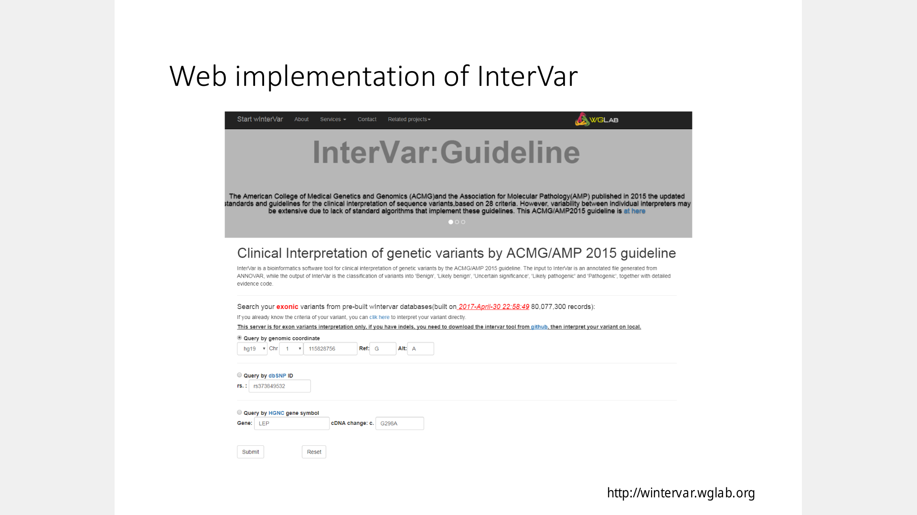

Slide 59


Slide 60
Day 4: SNP and sequencing based association studies

Slide 61


Slide 62


Slide 63






Slide 64


Slide 65


Slide 66


Slide 67
Day 4: Rare or de novo variants in human diseases

Slide 68


Slide 69


Slide 70


Slide 71


Slide 72


Slide 73
Day 5: RNA-Seq
Normalization

Slide 74


Slide 75


Slide 76


Slide 77


Slide 78


Slide 79




Slide 80




Slide 81


Slide 82


Slide 83


Slide 84



Slide 85


Slide 86
Day 5: Deep learning

Slide 87


Slide 88


Slide 89


时
间
序
列
模式识别

Slide 90


